Slide 1
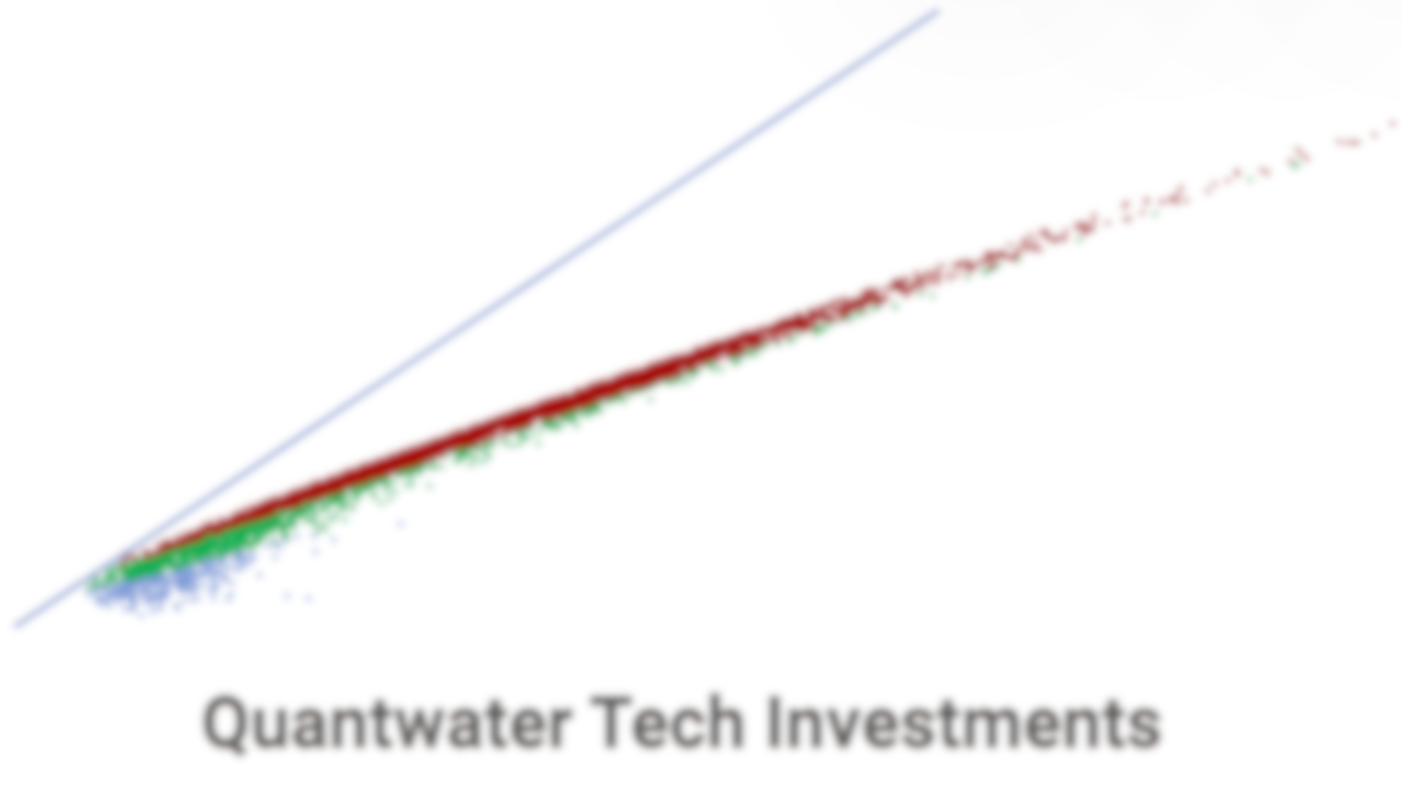
Project Spider Accelerating the Energy Transition 4thMar 2024 Pawan Quantwater Tech Investments
13th October 2025
Economic Data Releases & Their Historical Impact on Assets

Slide 2
Overview
Date | Day | Time (IST) | Cur. | Imp. | Event
13-Oct-25 | Mon | All Day |  | Holiday | Canada - Thanksgiving Day
13-Oct-25 | Mon | All Day |  | Holiday | Japan - National Sports Day
14-Oct-25 | Tue | 11:30 | EUR | 3 | German CPI (MoM) (Sep)
15-Oct-25 | Wed | 18:00 | USD | 3 | Core CPI (MoM) (Sep)
15-Oct-25 | Wed | 18:00 | USD | 3 | CPI (YoY) (Sep)
15-Oct-25 | Wed | 18:00 | USD | 3 | CPI (MoM) (Sep)
16-Oct-25 | Thu | 11:30 | GBP | 3 | GDP (MoM) (Aug)
16-Oct-25 | Thu | 18:00 | USD | 3 | Core Retail Sales (MoM) (Sep)
16-Oct-25 | Thu | 18:00 | USD | 3 | Philadelphia Fed Manufacturing Index (Oct)
16-Oct-25 | Thu | 18:00 | USD | 3 | PPI (MoM) (Sep)
16-Oct-25 | Thu | 18:00 | USD | 3 | Retail Sales (MoM) (Sep)
17-Oct-25 | Fri | 14:30 | EUR | 3 | CPI (YoY) (Sep)
29-Oct-25 | Wed | 23:30 | USD | 3 | USD - Fed Interest Rate Decision
Annexure: Key Terms & Links

Slide 3
Project Spider Accelerating the Energy Transition 4thMar 2024 Pawan Quantwater Tech Investments
German CPI (MoM) (Sep)

Slide 4
German CPI (MoM) (Sep)
Event | German CPI (MoM) (Sep) |  |  | Description
Actual: |  |  |  | The German Consumer Price Index (CPI) measures the changes in the price of goods and services purchased by consumers. A higher than expected reading should be taken as positive/bullish for the EUR, while a lower than expected reading should be taken as negative/bearish for the EUR. Learn More: EURJPY | EURUSD
Forecast:
Previous: | 0.20%
Time (GMT): | 06:00
Release Date | Actual | Forecast | Previous
30-Sep-25 | 0.20% | 0.20% | 0.10%
12-Sep-25 | 0.10% | 0.10% | 0.30%
29-Aug-25 | 0.10% | 0.00% | 0.30%
13-Aug-25 | 0.30% | 0.30% | 0.00%
31-Jul-25 | 0.30% | 0.20% | 0.00%
10-Jul-25 | 0.00% | 0.00% | 0.10%

Slide 5
Project Spider Accelerating the Energy Transition 4thMar 2024 Pawan Quantwater Tech Investments
German CPI (MoM) (Sep)
EURJPY

Slide 6
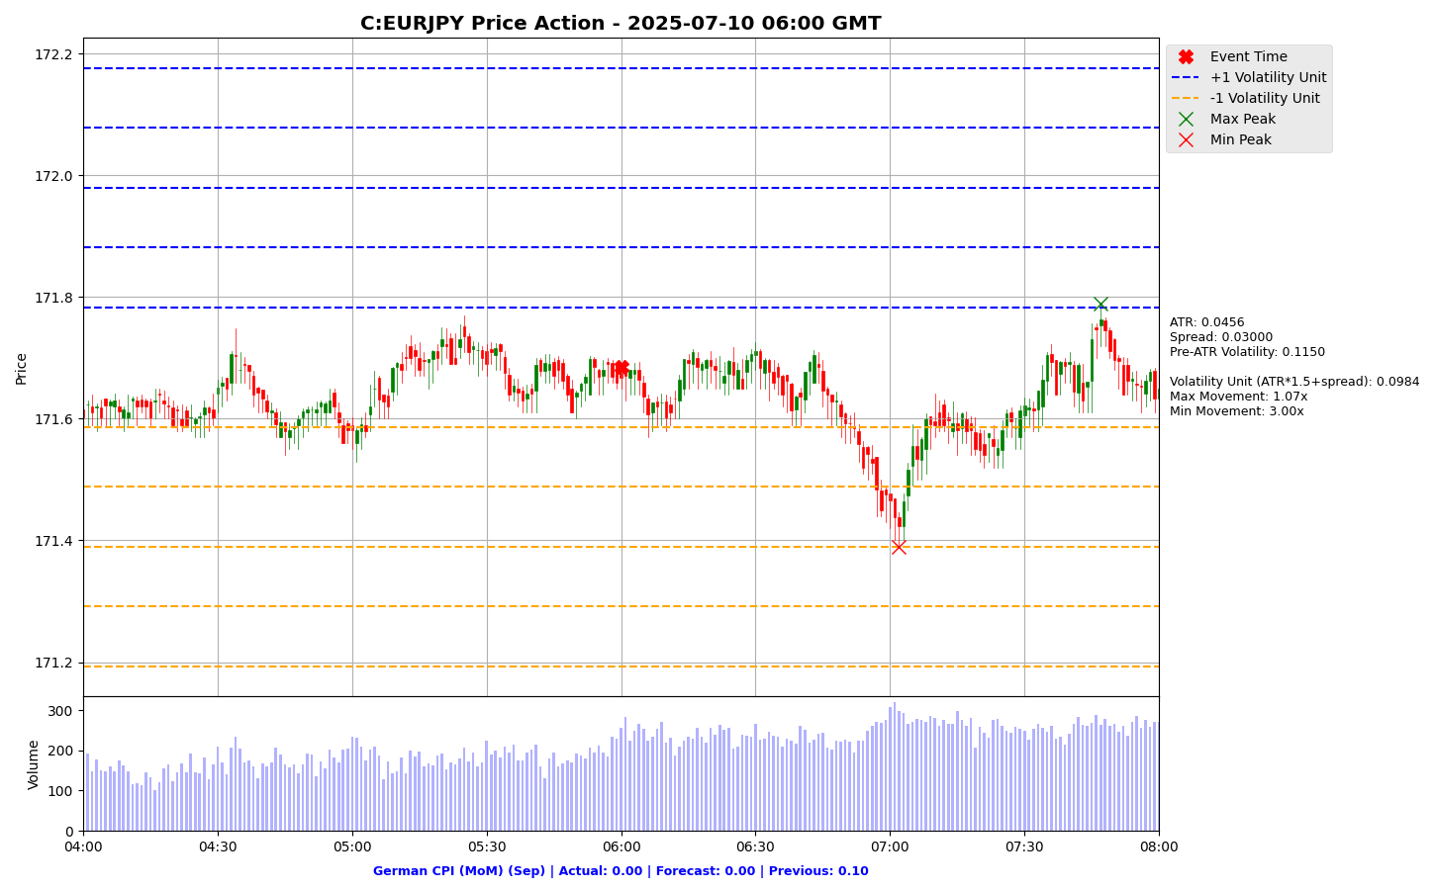

Slide 7
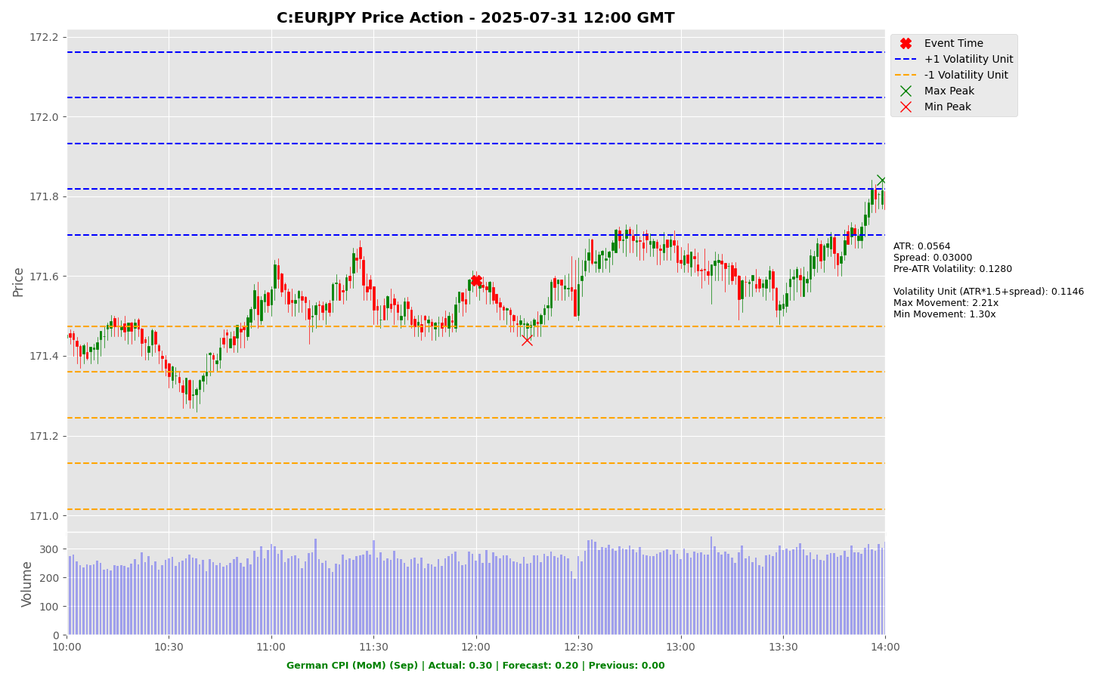

Slide 8
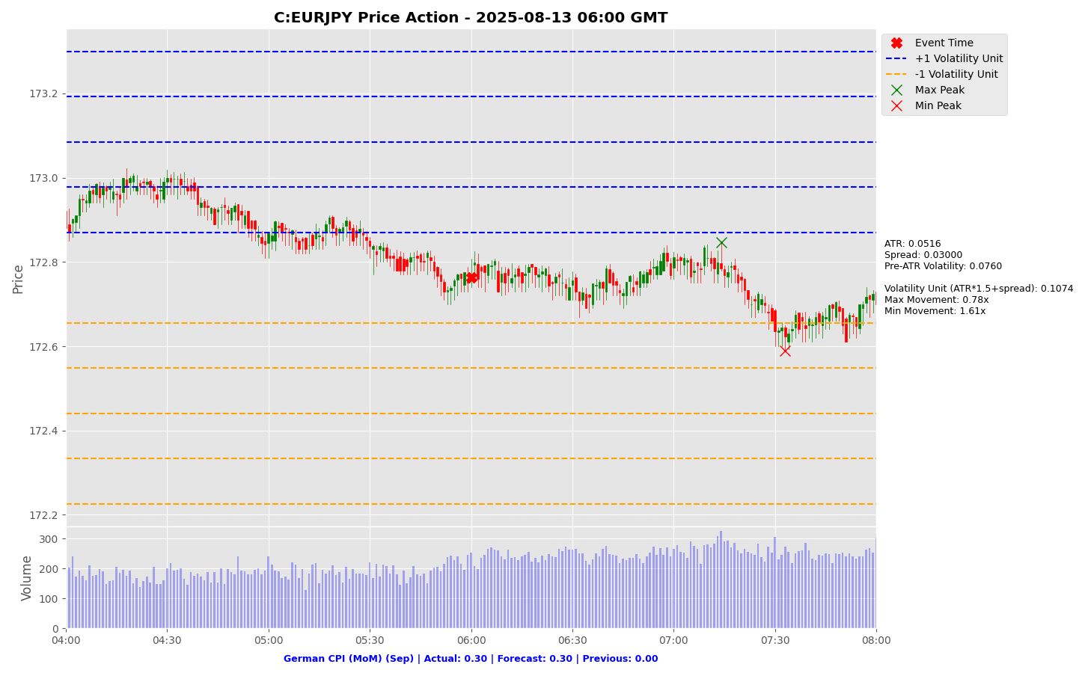

Slide 9
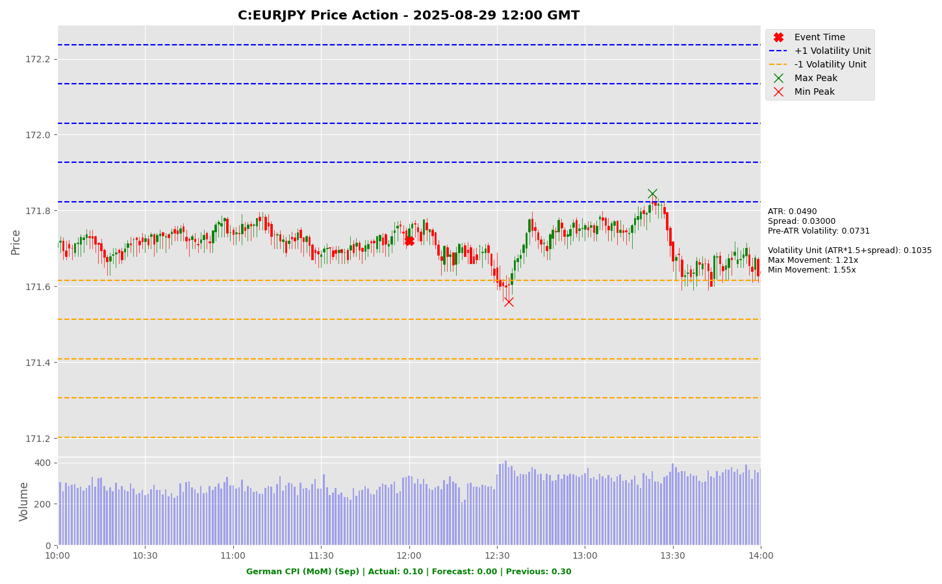

Slide 10
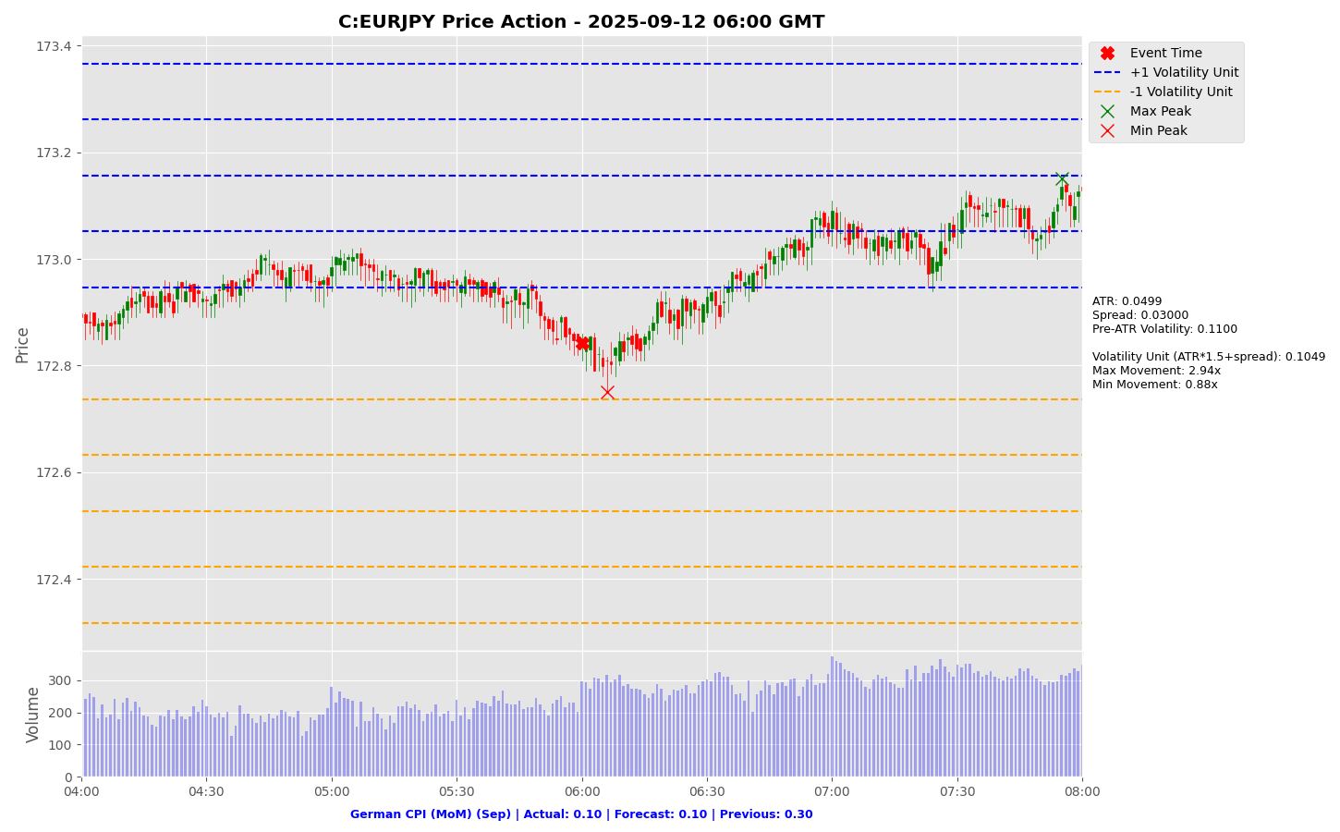

Slide 11
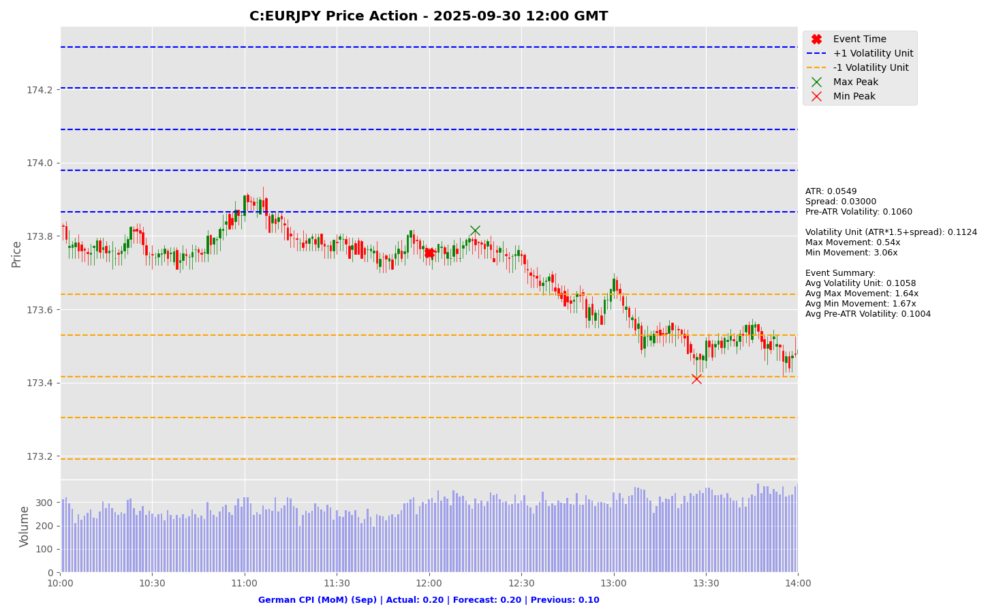

Slide 12
Project Spider Accelerating the Energy Transition 4thMar 2024 Pawan Quantwater Tech Investments
German CPI (MoM) (Sep)
EURUSD

Slide 13
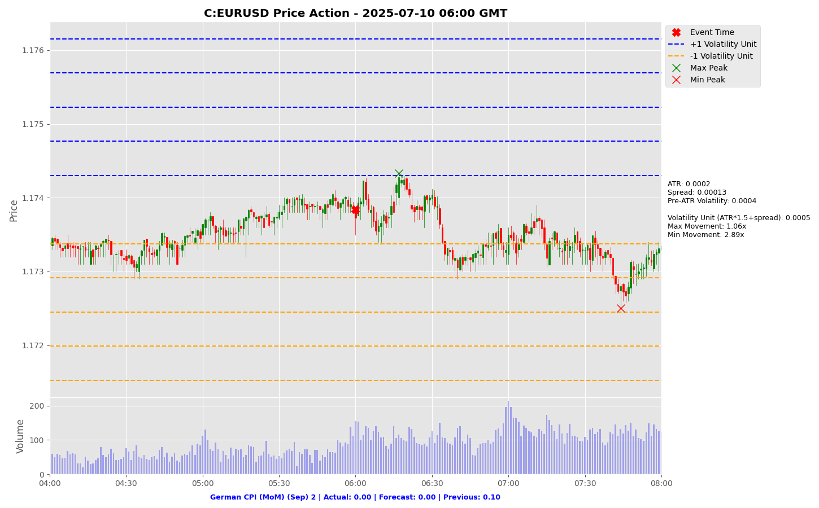

Slide 14
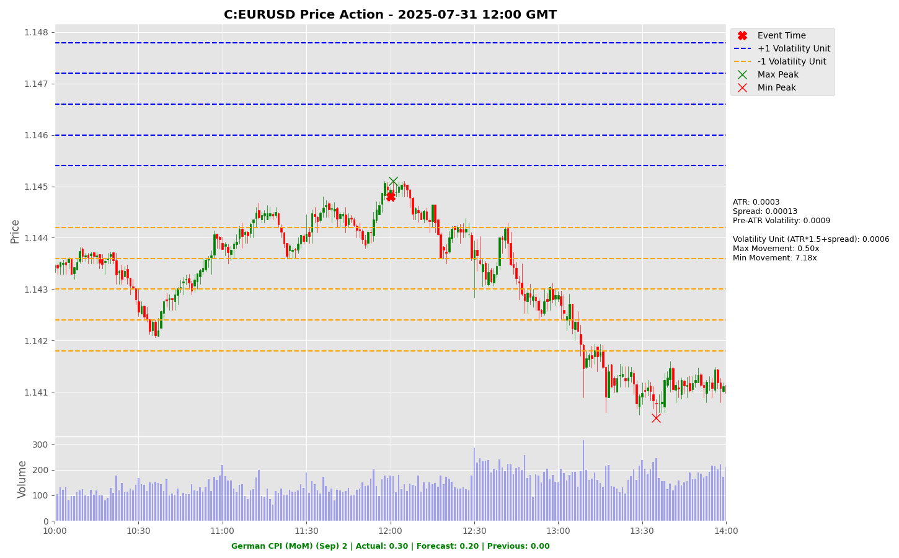

Slide 15
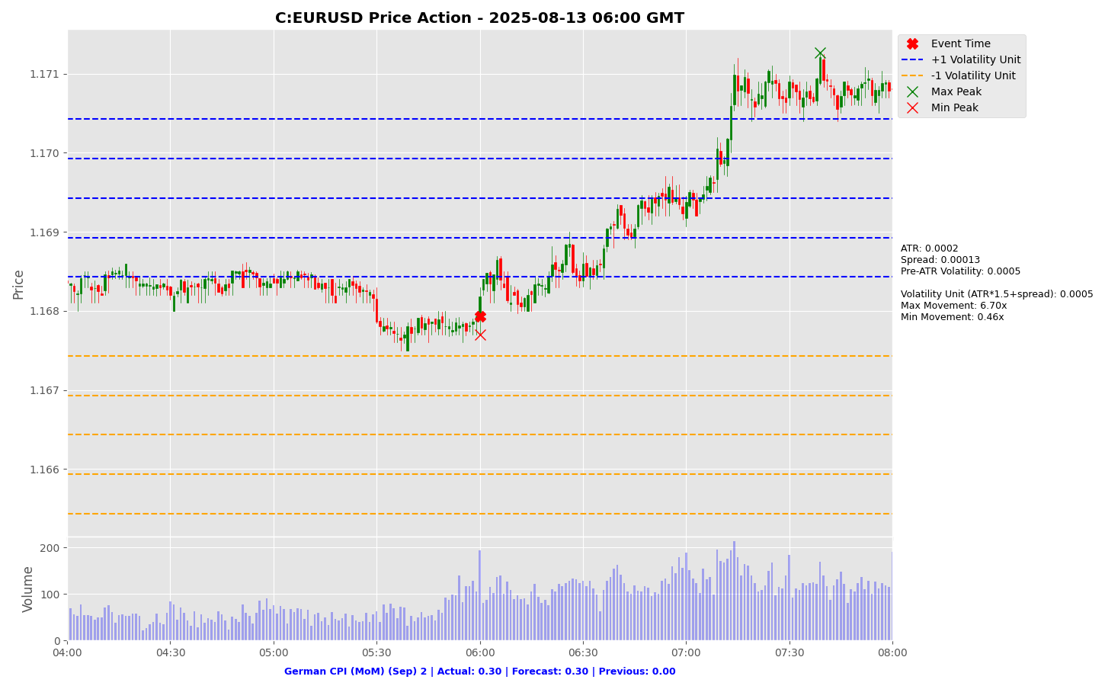

Slide 16
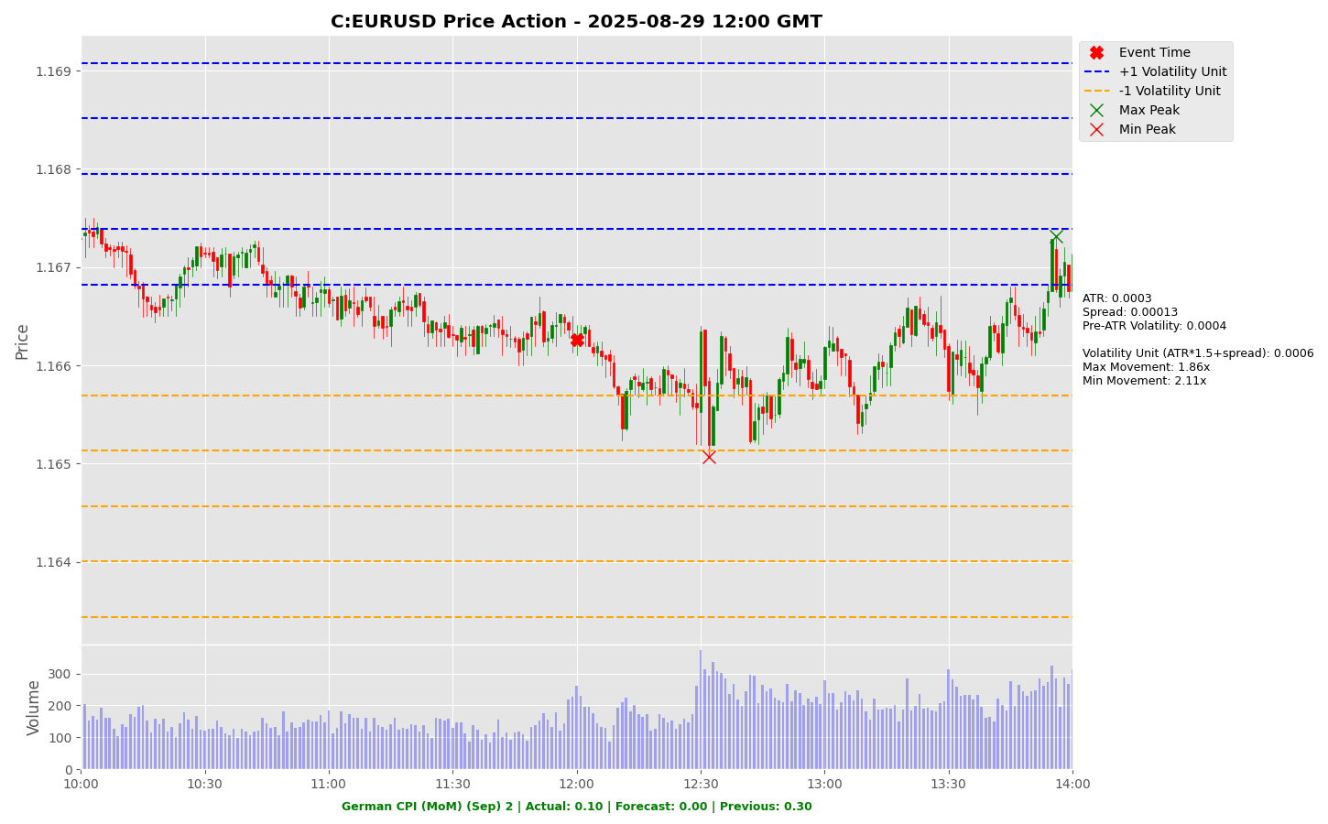

Slide 17
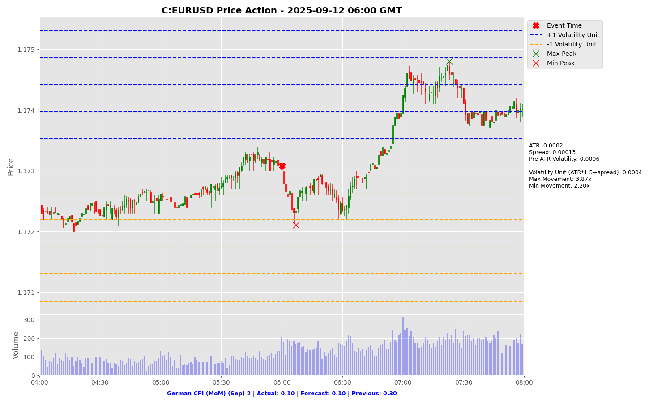

Slide 18
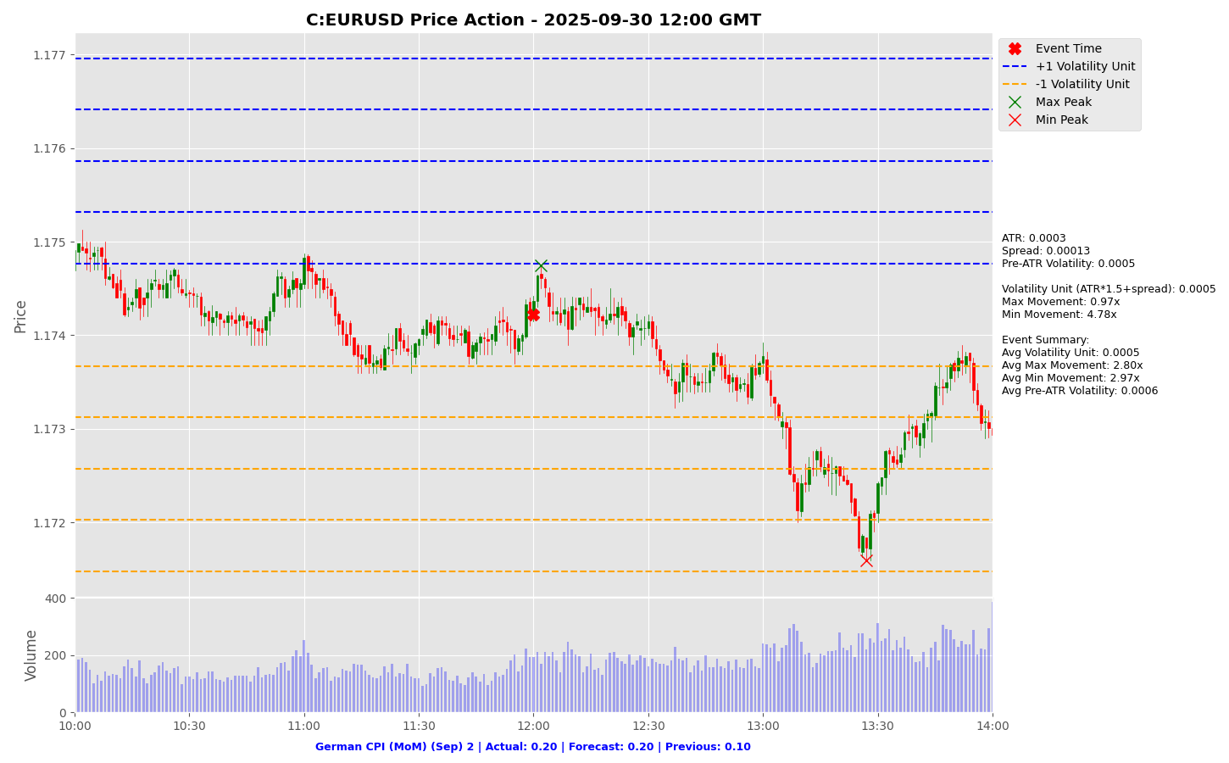

Slide 19
Project Spider Accelerating the Energy Transition 4thMar 2024 Pawan Quantwater Tech Investments
Core CPI (MoM) (Sep)

Slide 20
Core CPI (MoM) (Sep)
Event | Core CPI (MoM) (Sep) |  |  | Description
Actual: |  |  |  | The Core Consumer Price Index (CPI) measures the changes in the price of goods and services, excluding food and energy. The CPI measures price change from the perspective of the consumer. It is a key way to measure changes in purchasing trends and inflation. A higher than expected reading should be taken as positive/bullish for the USD, while a lower than expected reading should be taken as negative/bearish for the USD. Learn More: USDJPY | EURUSD
Forecast:
Previous: | 0.3%
Time (GMT): | 12:30
Release Date | Actual | Forecast | Previous
11-Sep-25 | 0.300% | 0.300% | 0.300%
12-Aug-25 | 0.300% | 0.300% | 0.200%
15-Jul-25 | 0.200% | 0.300% | 0.100%
11-Jun-25 | 0.100% | 0.300% | 0.200%
13-May-25 | 0.200% | 0.300% | 0.100%
10-Apr-25 | 0.100% | 0.300% | 0.200%

Slide 21
Project Spider Accelerating the Energy Transition 4thMar 2024 Pawan Quantwater Tech Investments
Core CPI (MoM) (Sep)
USDJPY

Slide 22
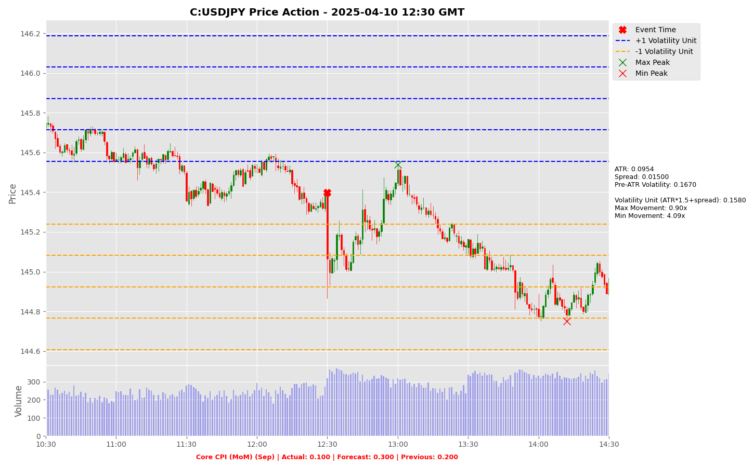

Slide 23
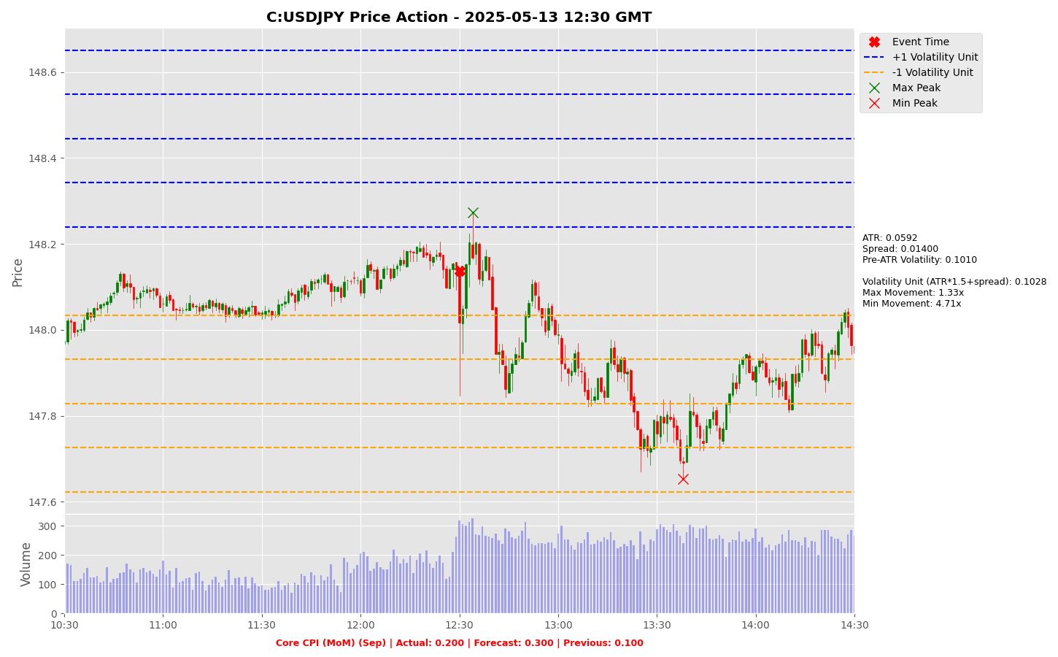

Slide 24
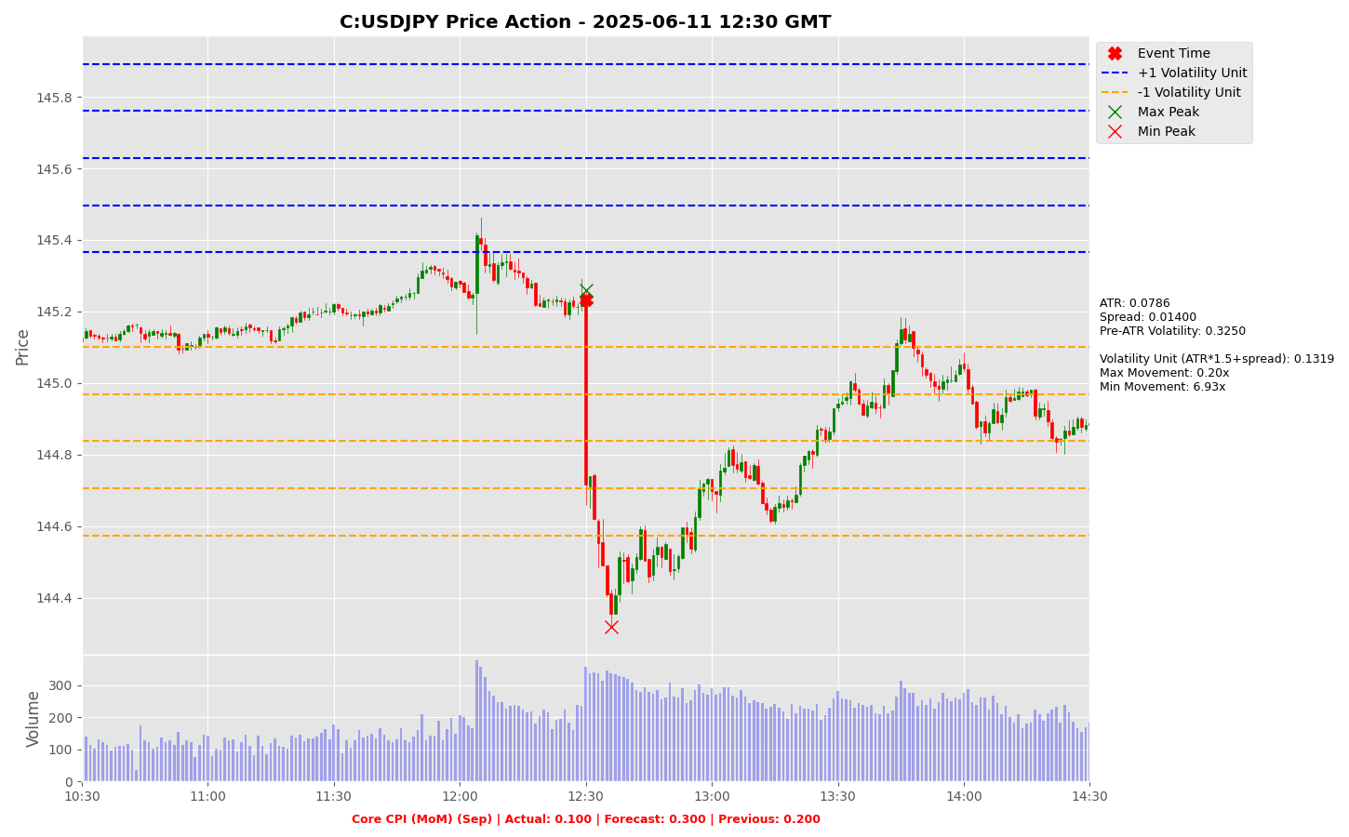

Slide 25
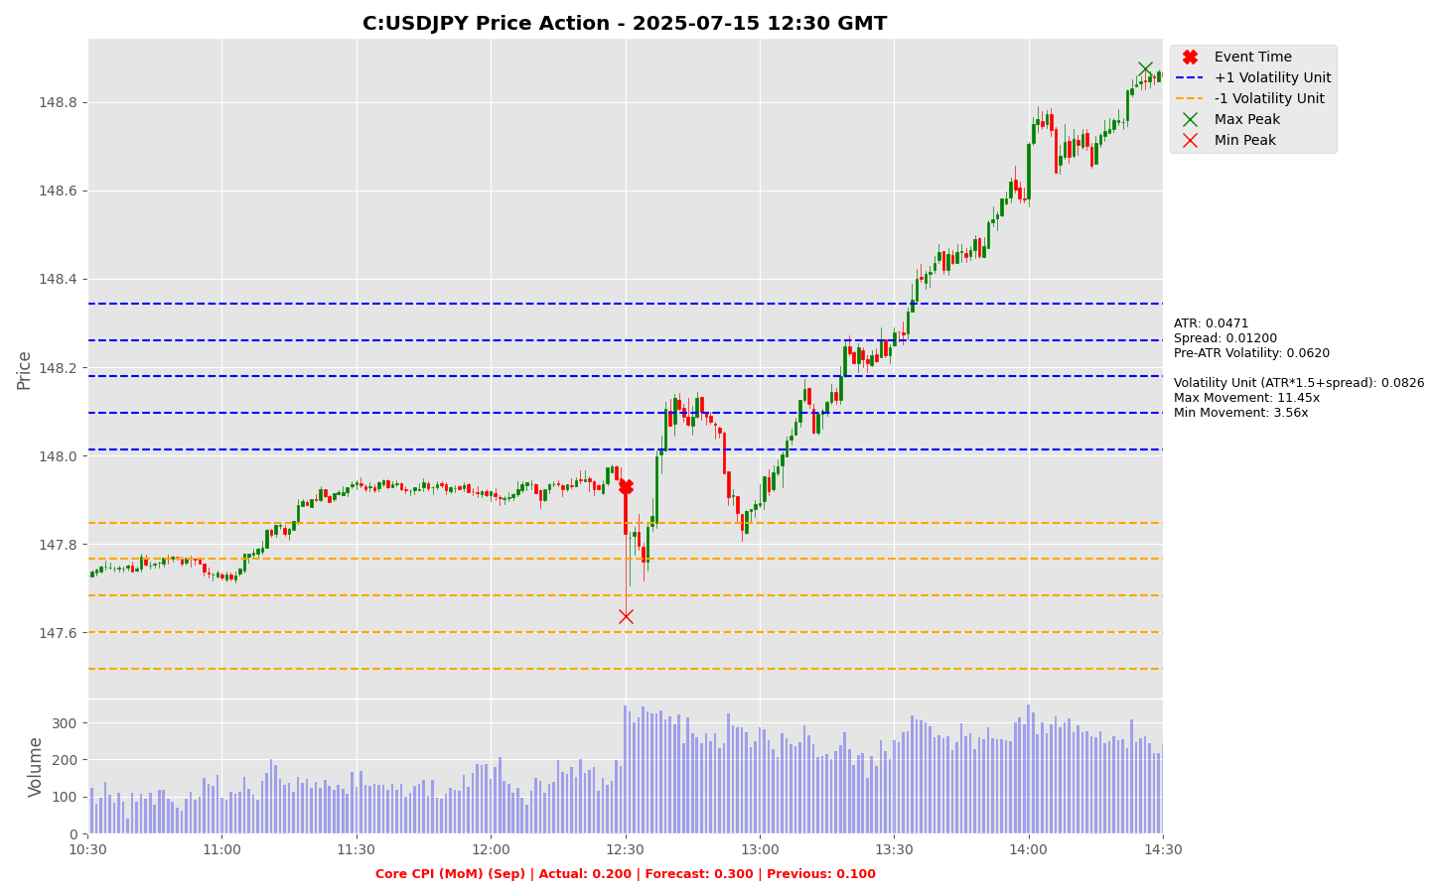

Slide 26
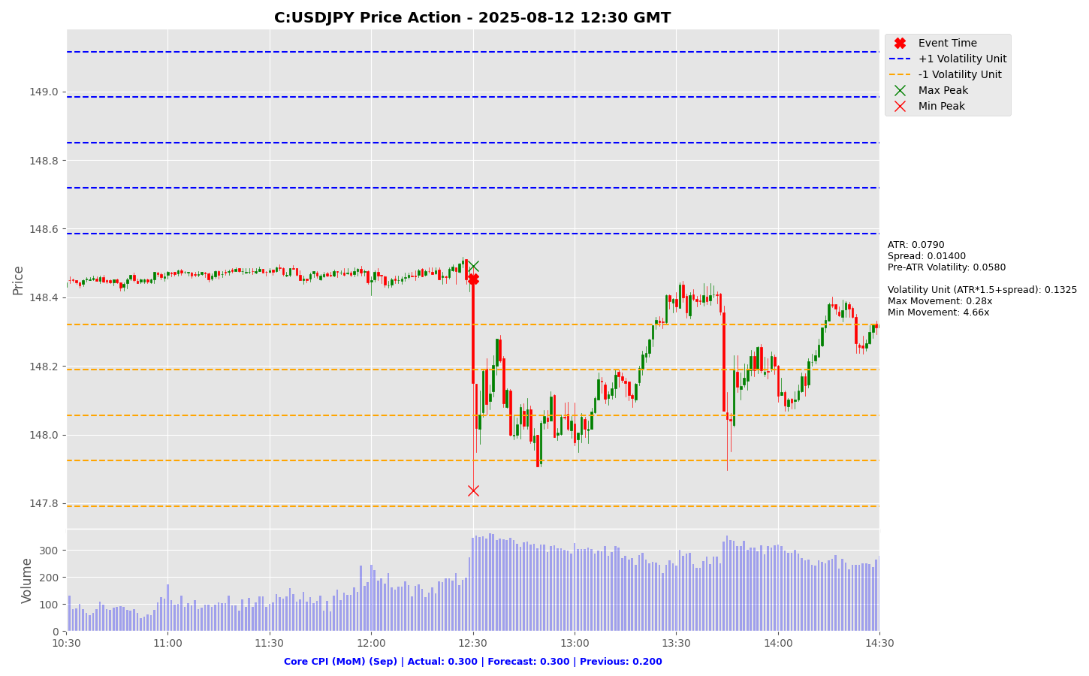

Slide 27
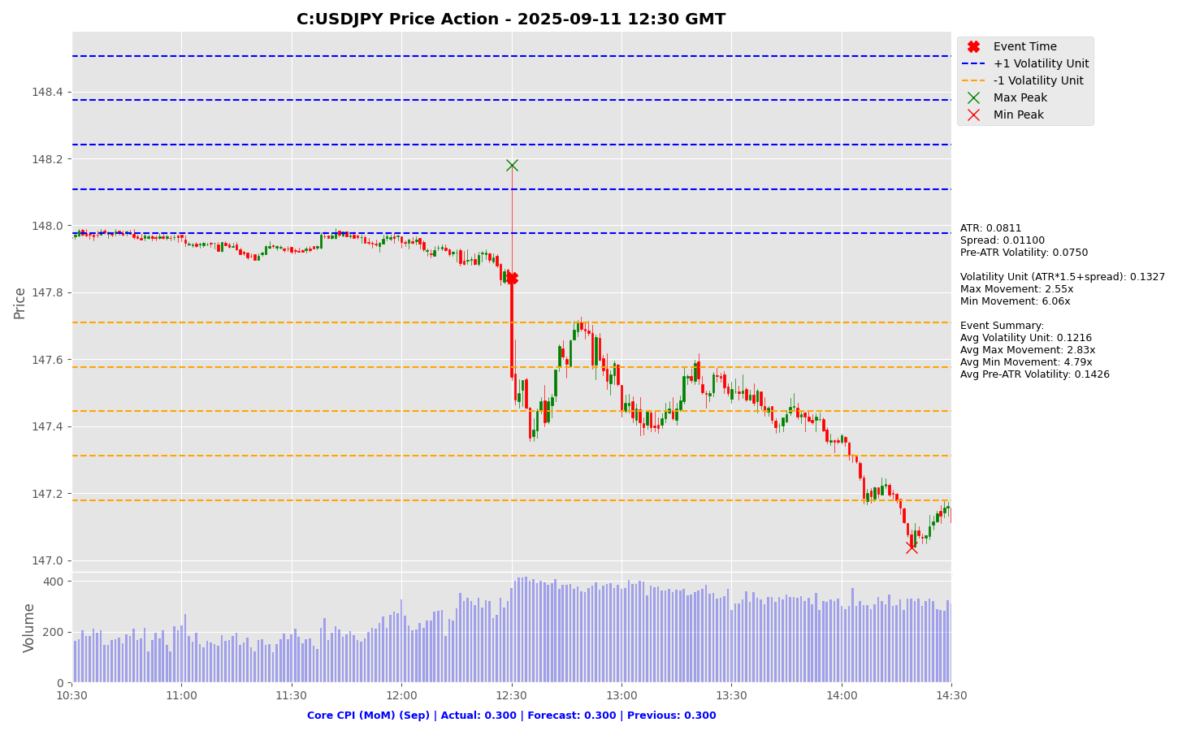

Slide 28
Project Spider Accelerating the Energy Transition 4thMar 2024 Pawan Quantwater Tech Investments
Core CPI (MoM) (Sep)
EURUSD

Slide 29
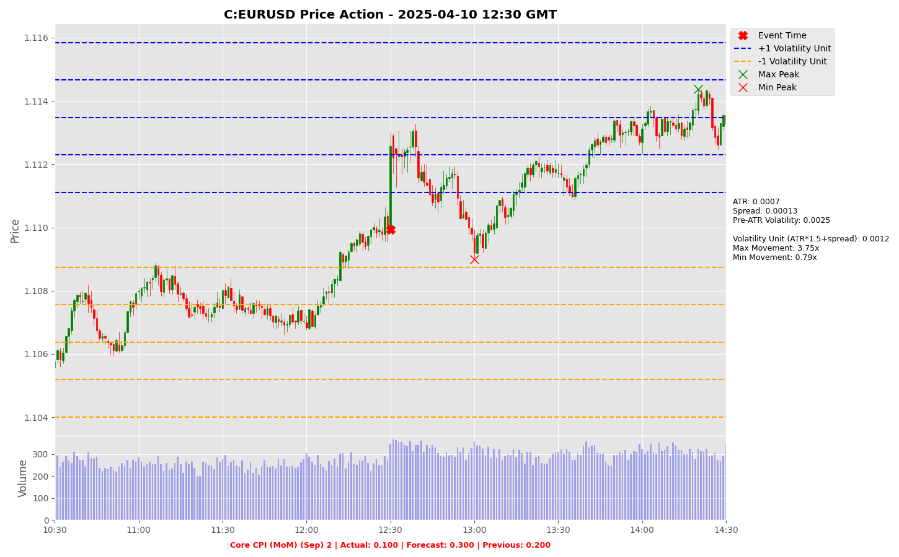

Slide 30
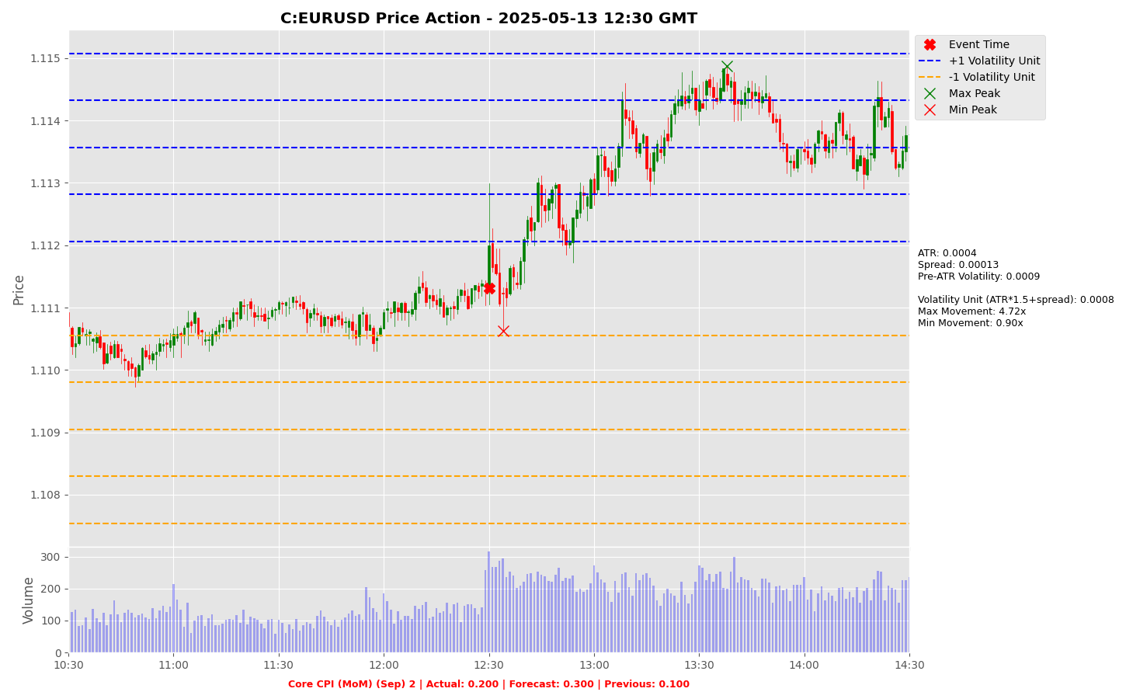

Slide 31
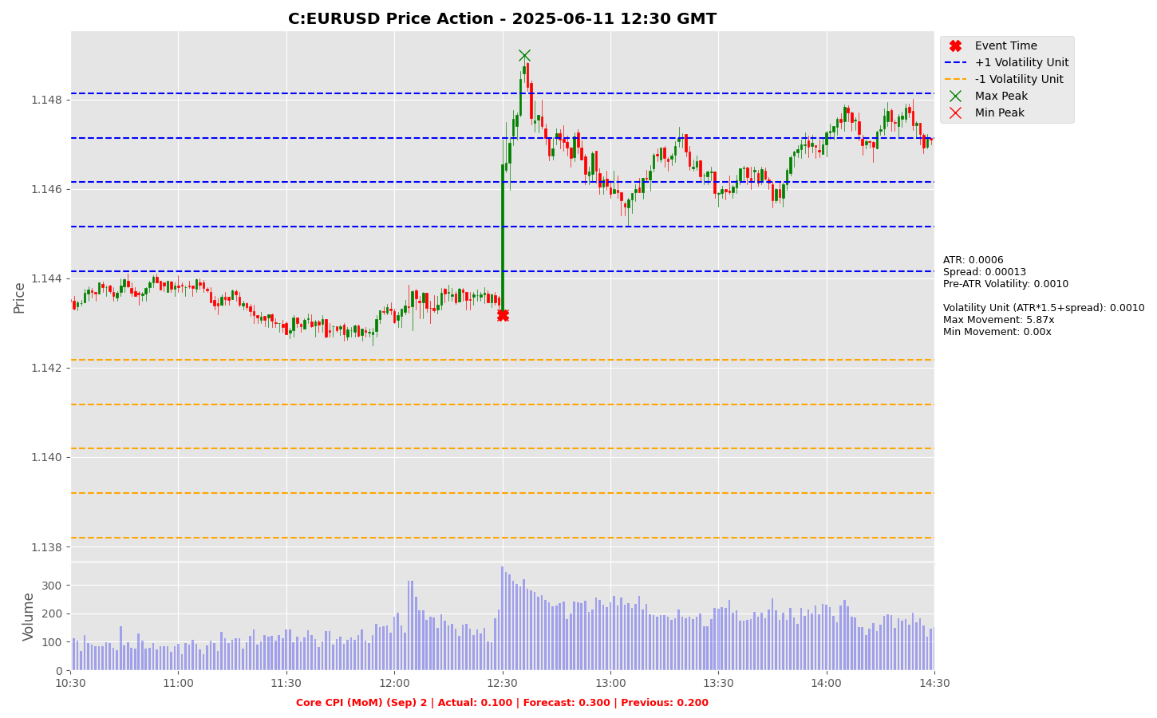

Slide 32
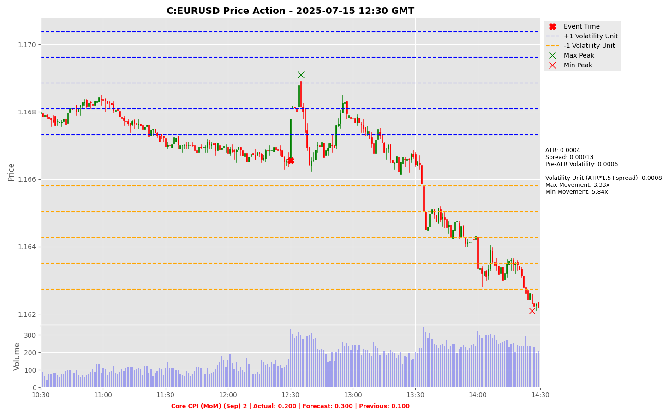

Slide 33
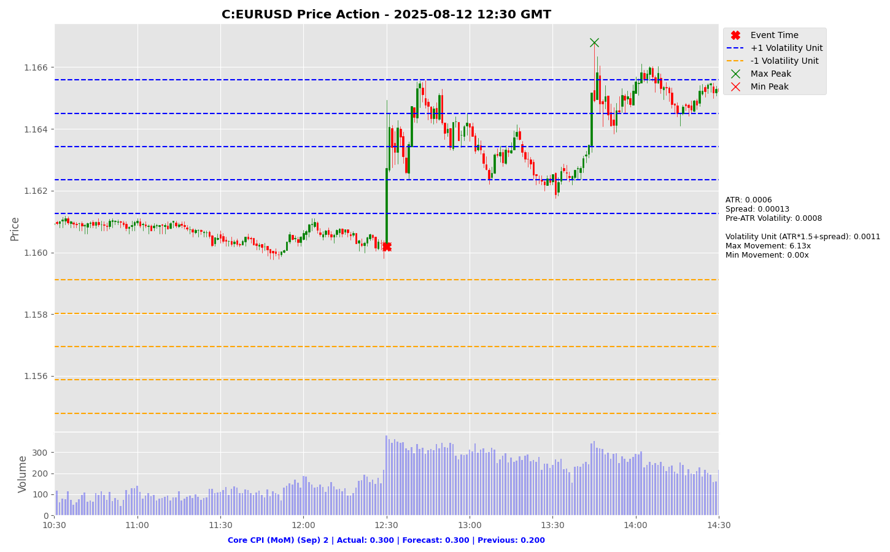

Slide 34
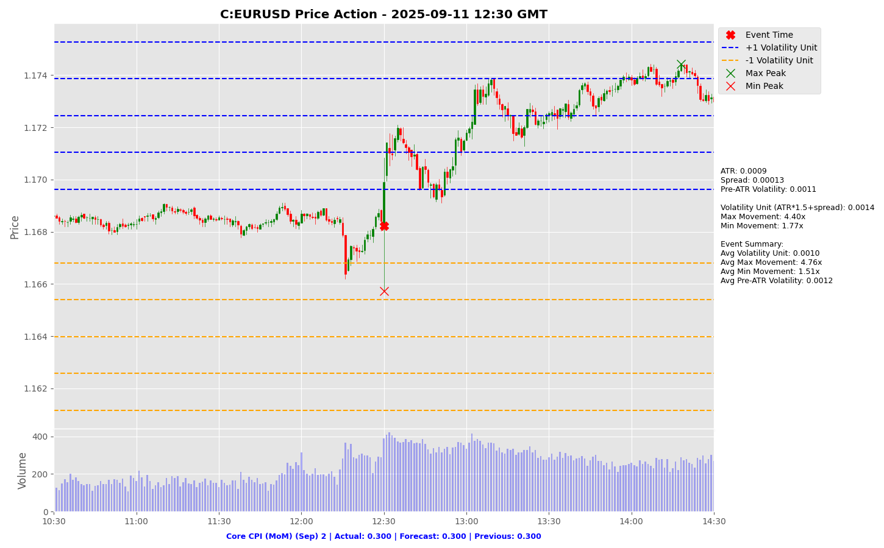

Slide 35
Project Spider Accelerating the Energy Transition 4thMar 2024 Pawan Quantwater Tech Investments
CPI (YoY) (Sep)

Slide 36
CPI (YoY) (Sep)
Event | CPI (YoY) (Sep) |  |  | Description
Actual: |  |  |  | The Consumer Price Index (CPI) measures the change in the price of goods and services from the perspective of the consumer. It is a key way to measure changes in purchasing trends and inflation. A higher than expected reading should be taken as positive/bullish for the USD, while a lower than expected reading should be taken as negative/bearish for the USD. Learn More: USDJPY | EURUSD
Forecast:
Previous: | 2.90%
Time (GMT): | 12:30
Release Date | Actual | Forecast | Previous
Sep 11, 2025 | 2.90% | 2.90% | 2.70%
Aug 12, 2025 | 2.70% | 2.80% | 2.70%
Jul 15, 2025 | 2.70% | 2.60% | 2.40%
Jun 11, 2025 | 2.40% | 2.50% | 2.30%
May 13, 2025 | 2.30% | 2.40% | 2.40%
Apr 10, 2025 | 2.40% | 2.50% | 2.80%

Slide 37
Project Spider Accelerating the Energy Transition 4thMar 2024 Pawan Quantwater Tech Investments
CPI (YoY) (Sep)
USDJPY

Slide 38
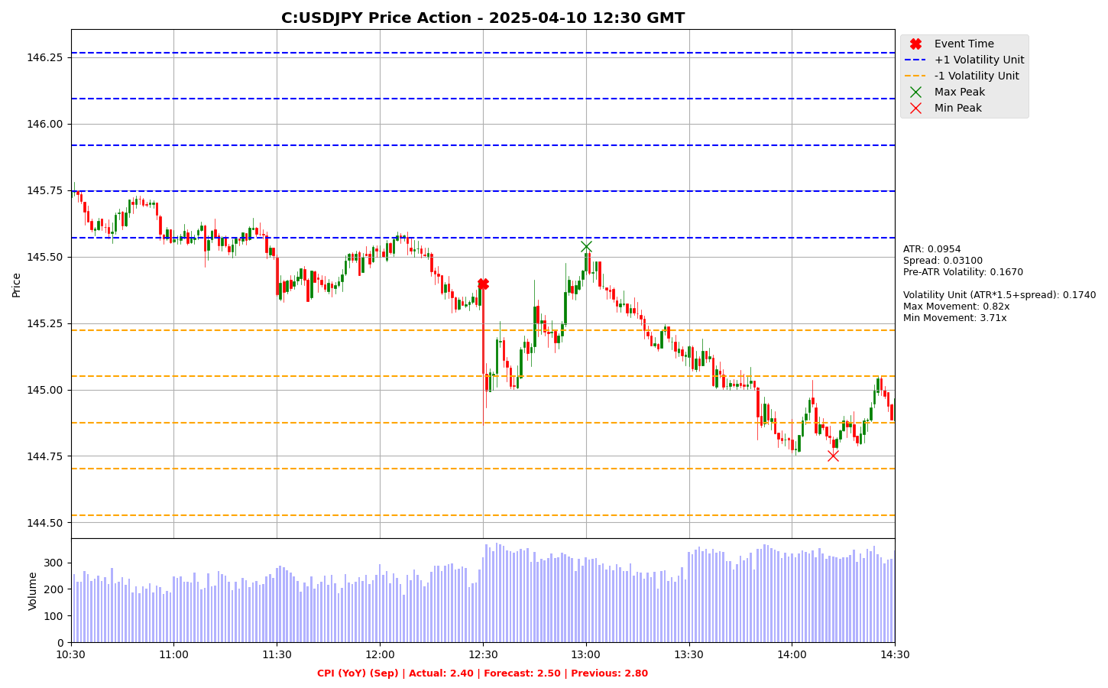

Slide 39
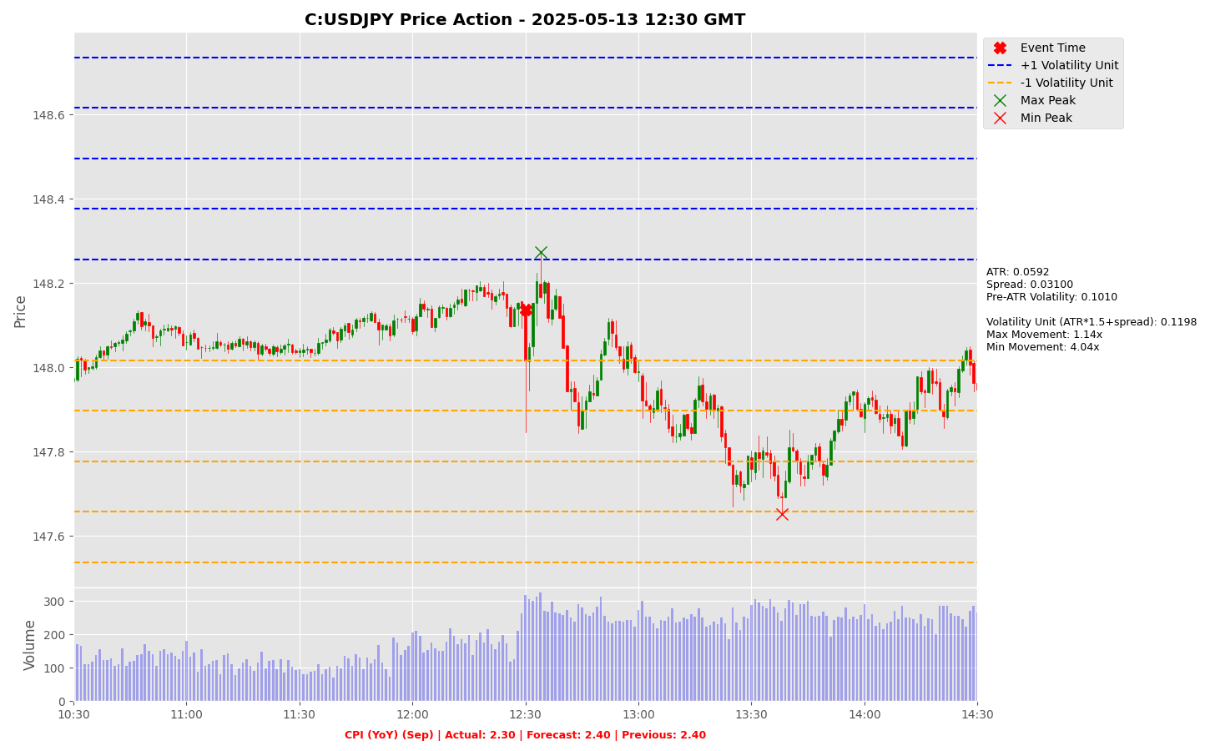

Slide 40
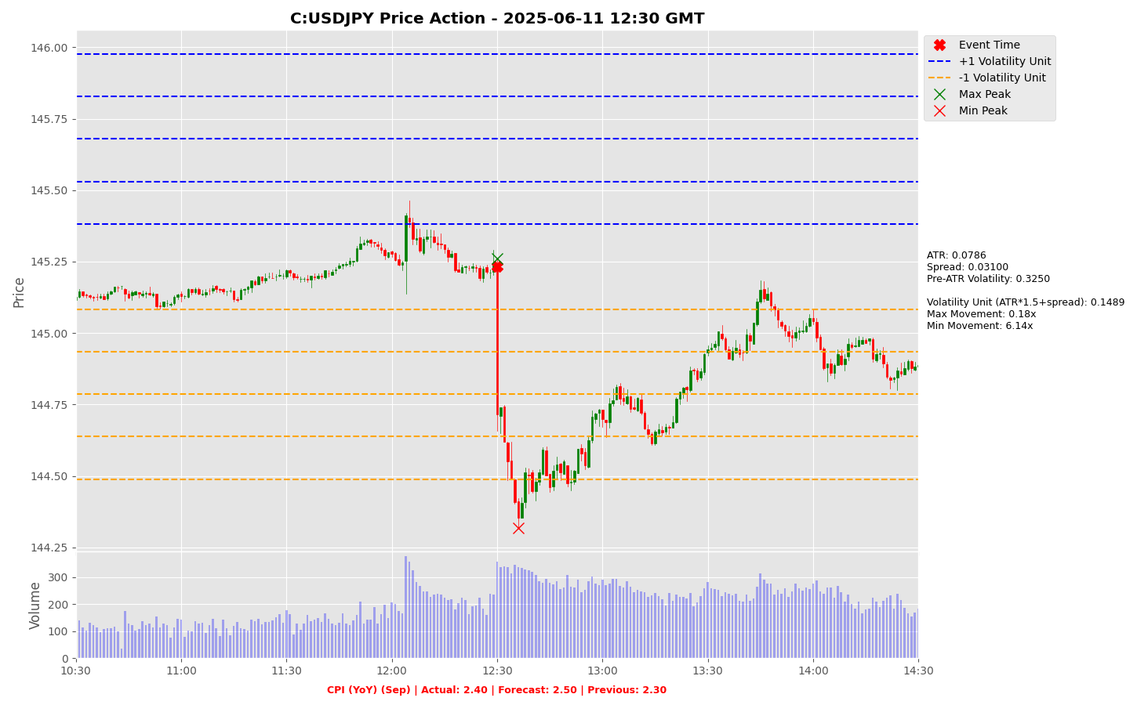

Slide 41
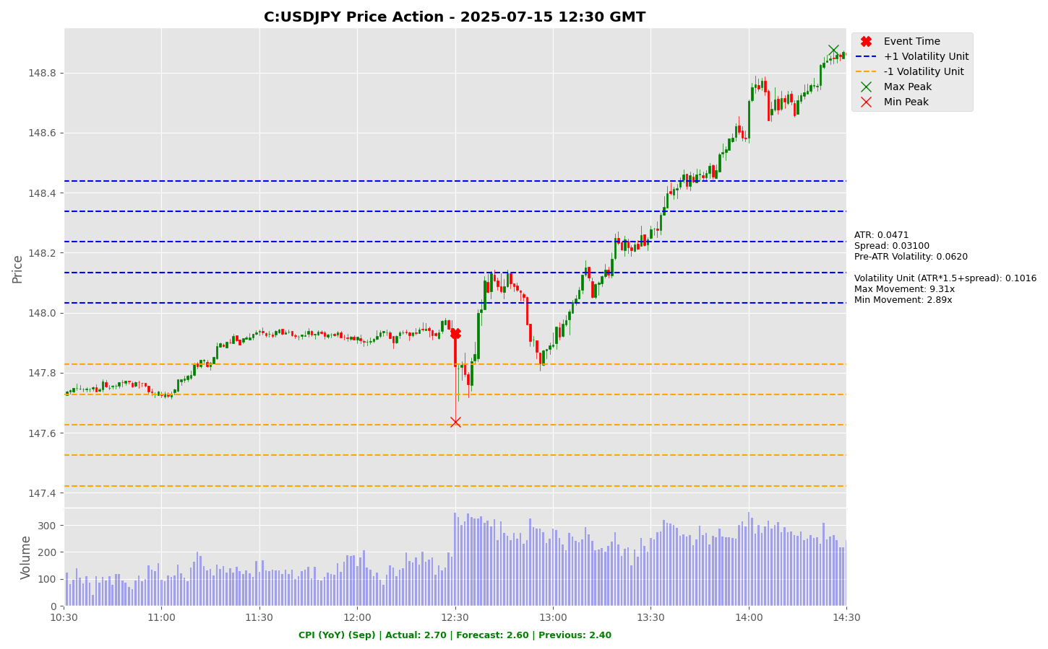

Slide 42
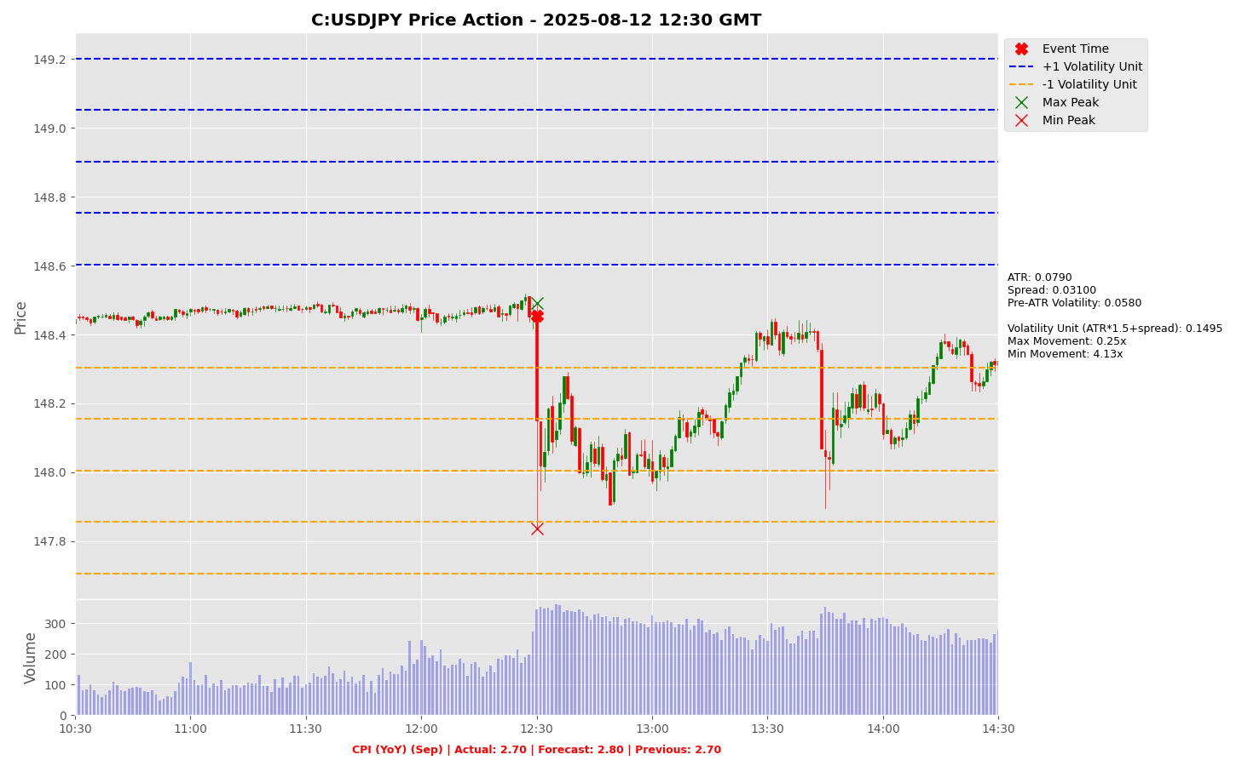

Slide 43
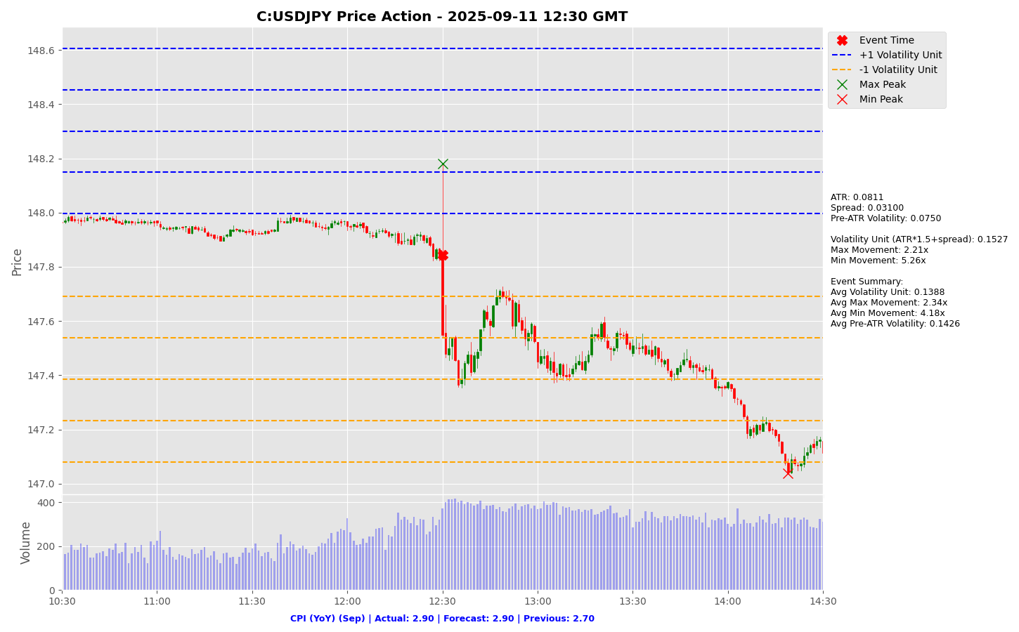

Slide 44
Project Spider Accelerating the Energy Transition 4thMar 2024 Pawan Quantwater Tech Investments
CPI (YoY) (Sep)
EURUSD

Slide 45
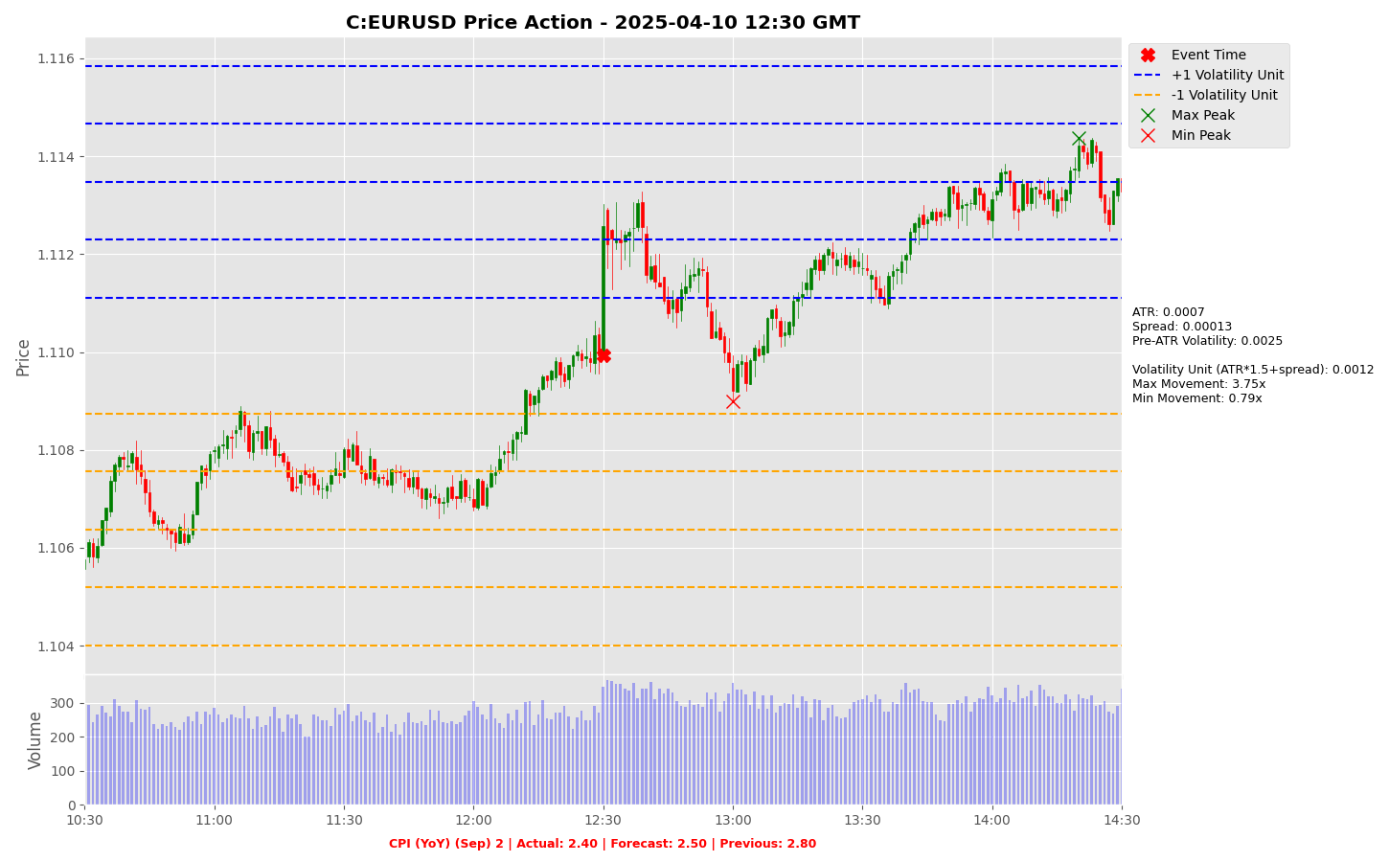

Slide 46
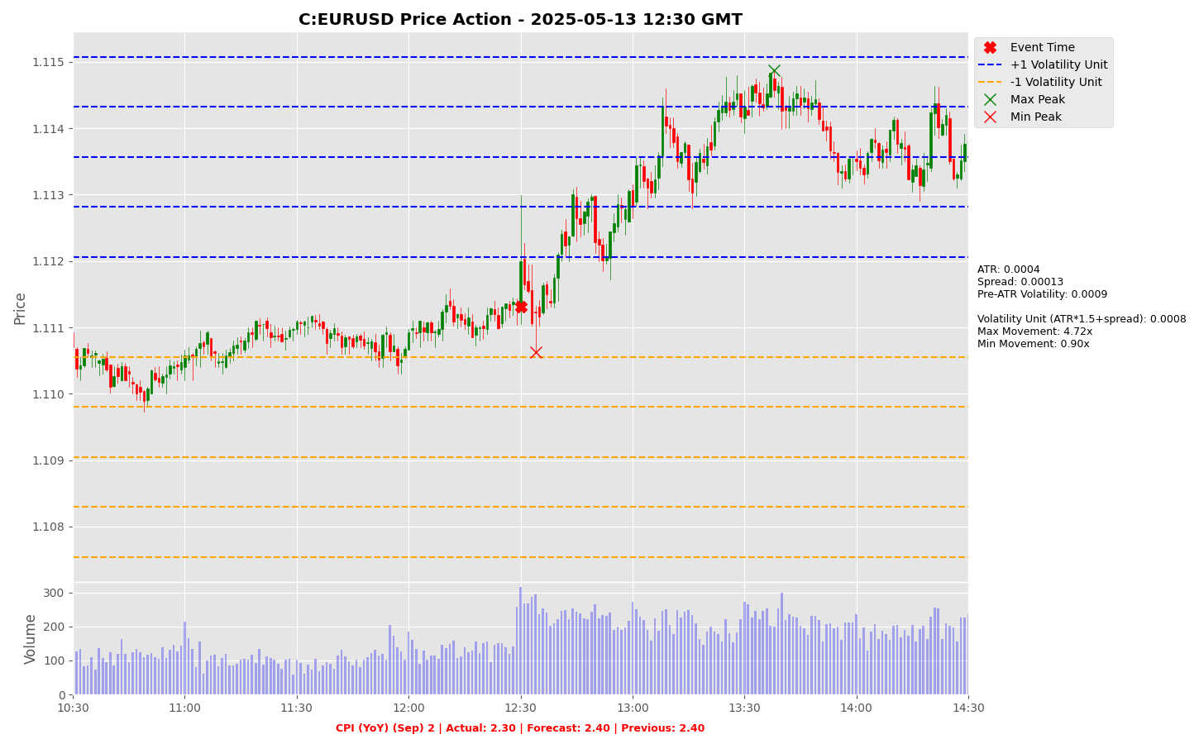

Slide 47


Slide 48
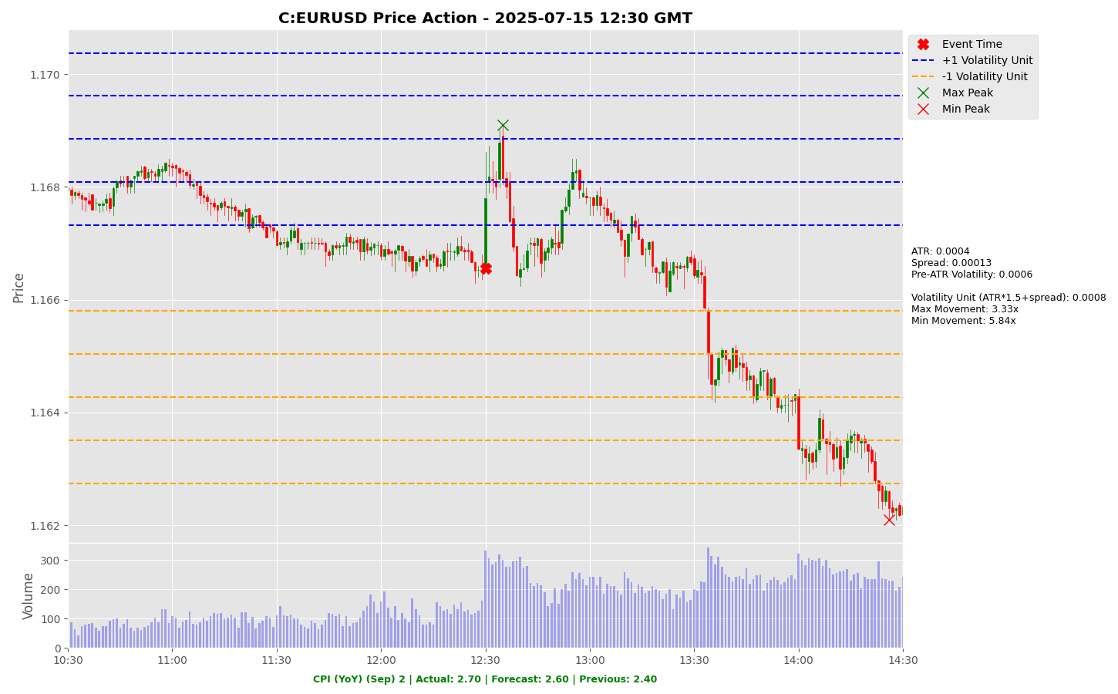

Slide 49
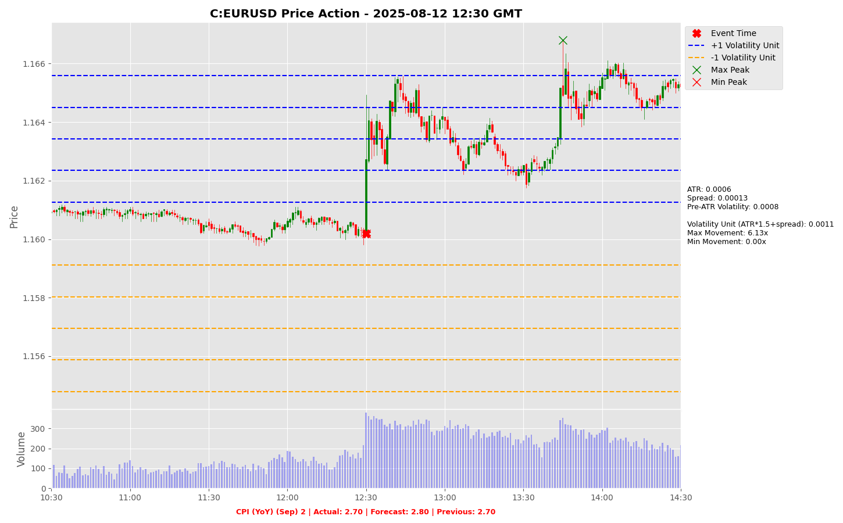

Slide 50


Slide 51
Project Spider Accelerating the Energy Transition 4thMar 2024 Pawan Quantwater Tech Investments
CPI (MoM) (Sep)

Slide 52
CPI (MoM) (Sep)
Event | CPI (MoM) (Sep) |  |  | Description
Actual: |  |  |  | The Consumer Price Index (CPI) measures the change in the price of goods and services from the perspective of the consumer. It is a key way to measure changes in purchasing trends and inflation. A higher than expected reading should be taken as positive/bullish for the USD, while a lower than expected reading should be taken as negative/bearish for the USD. Learn More: USDJPY | EURUSD
Forecast:
Previous: | 0.40%
Time (GMT): | 12:30
Release Date | Actual | Forecast | Previous
11-Sep-25 | 0.40% | 0.30% | 0.20%
12-Aug-25 | 0.20% | 0.20% | 0.30%
15-Jul-25 | 0.30% | 0.30% | 0.10%
11-Jun-25 | 0.10% | 0.20% | 0.20%
13-May-25 | 0.20% | 0.30% | -0.10%
10-Apr-25 | -0.10% | 0.10% | 0.20%

Slide 53
Project Spider Accelerating the Energy Transition 4thMar 2024 Pawan Quantwater Tech Investments
CPI (MoM) (Sep)
USDJPY

Slide 54
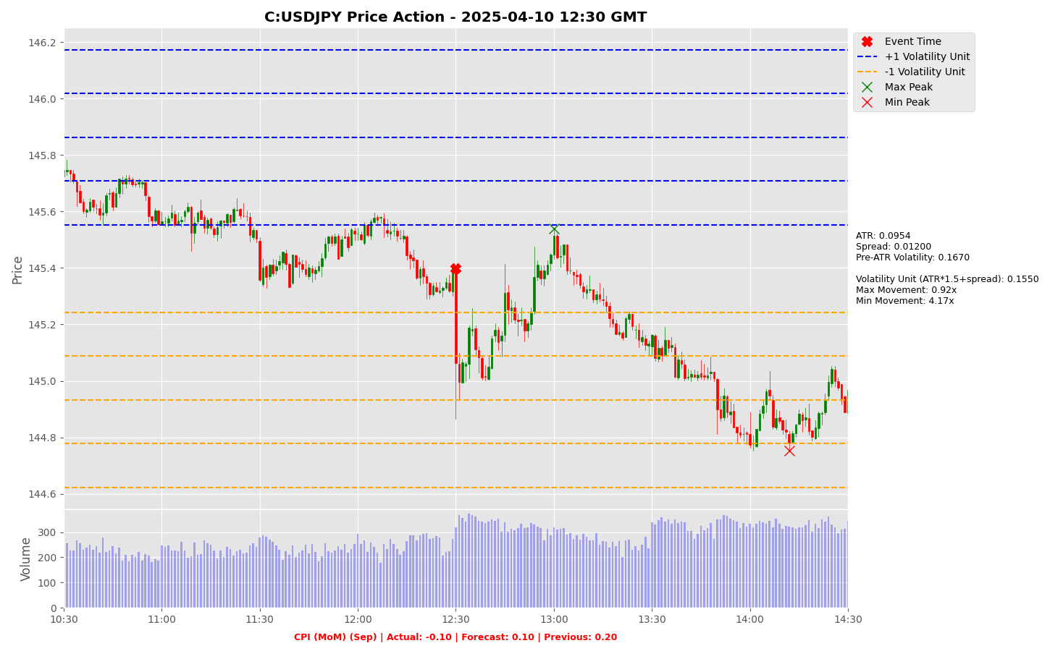

Slide 55


Slide 56


Slide 57
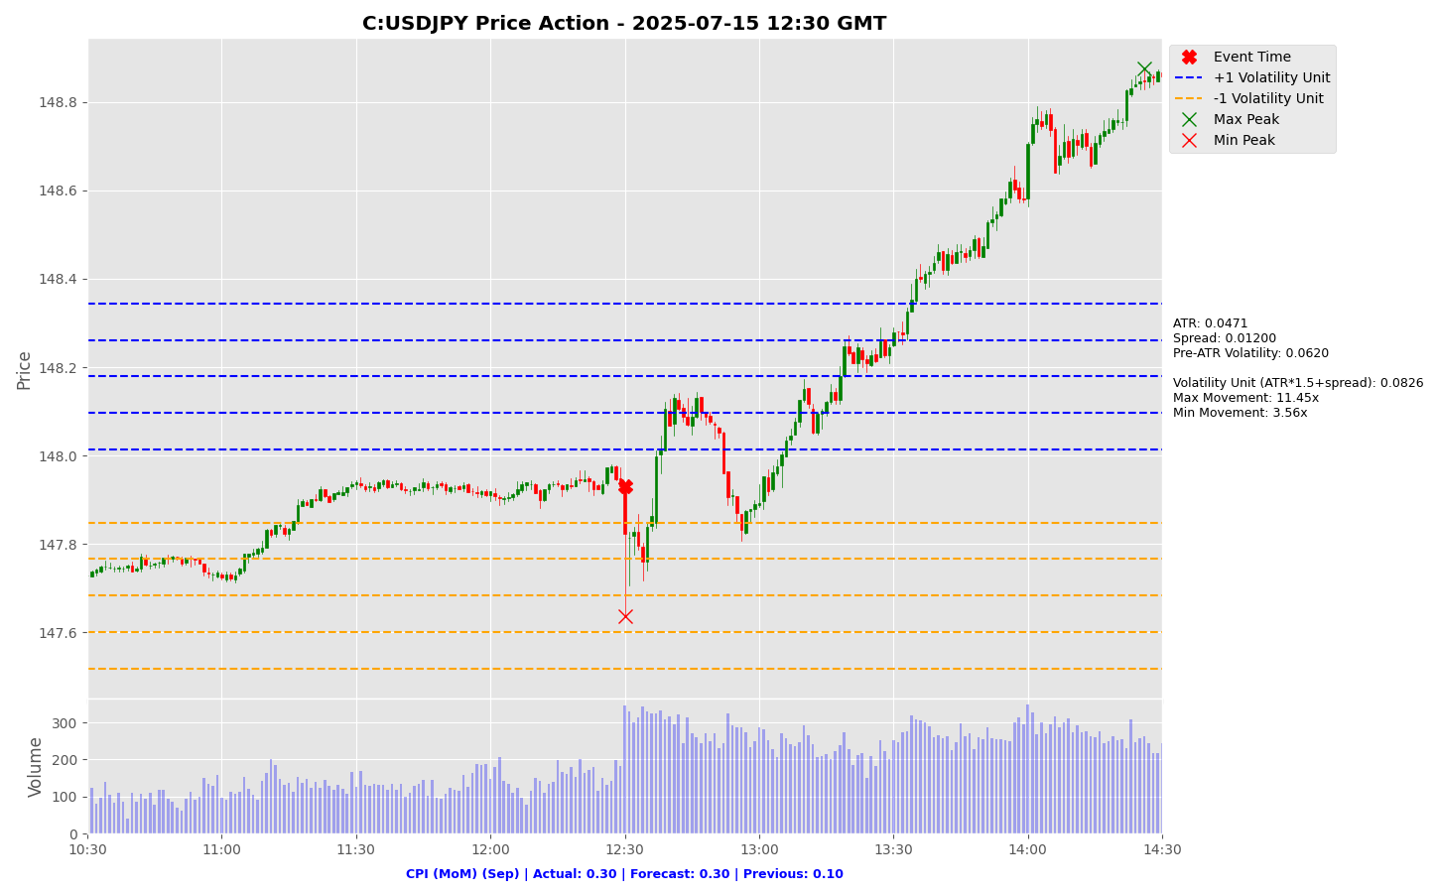

Slide 58
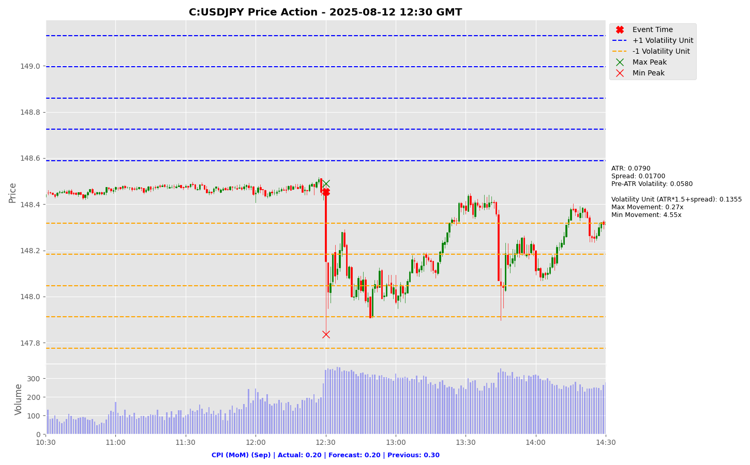

Slide 59
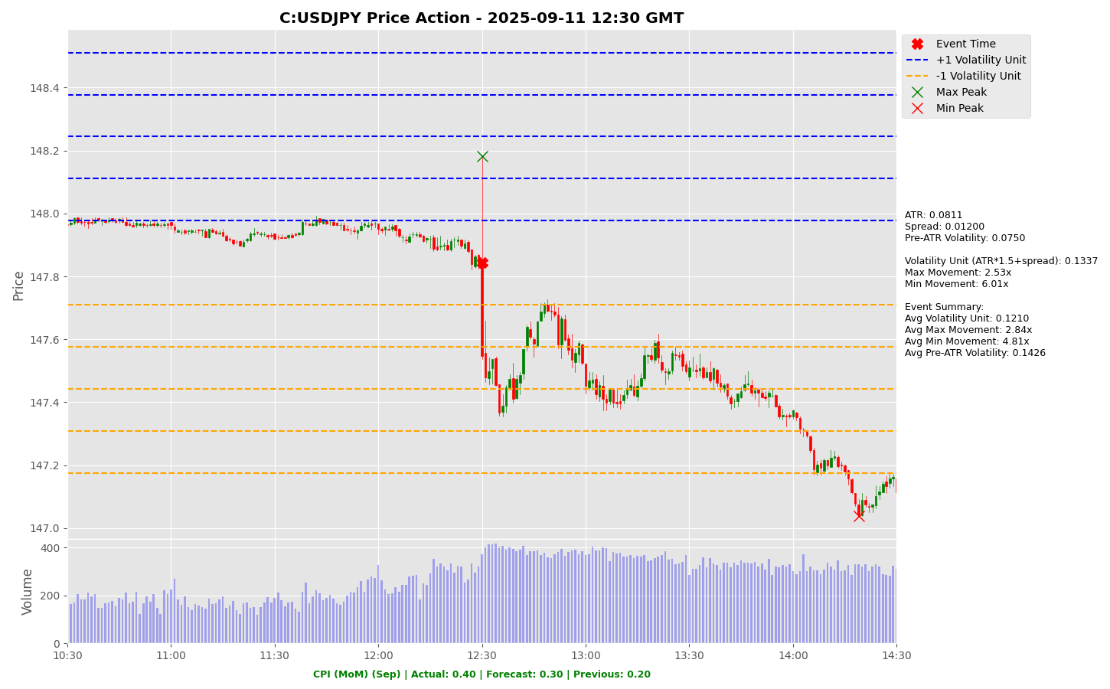

Slide 60
Project Spider Accelerating the Energy Transition 4thMar 2024 Pawan Quantwater Tech Investments
CPI (MoM) (Sep)
EURUSD

Slide 61


Slide 62
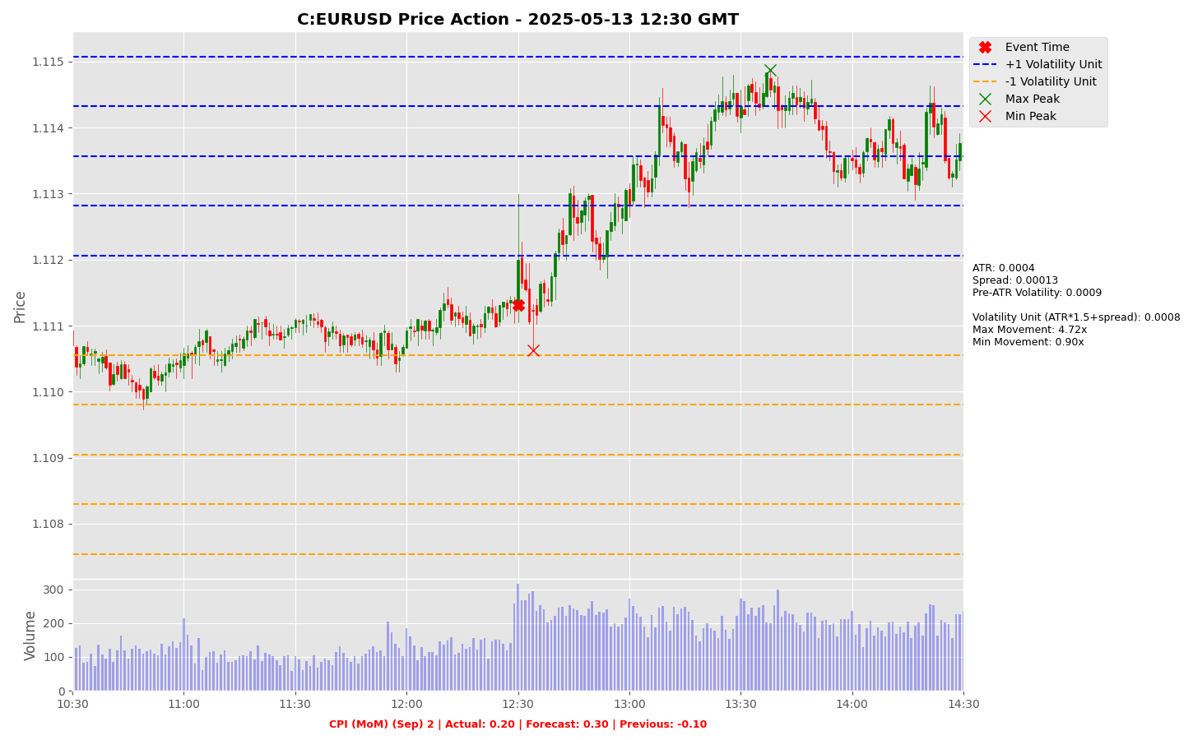

Slide 63


Slide 64


Slide 65
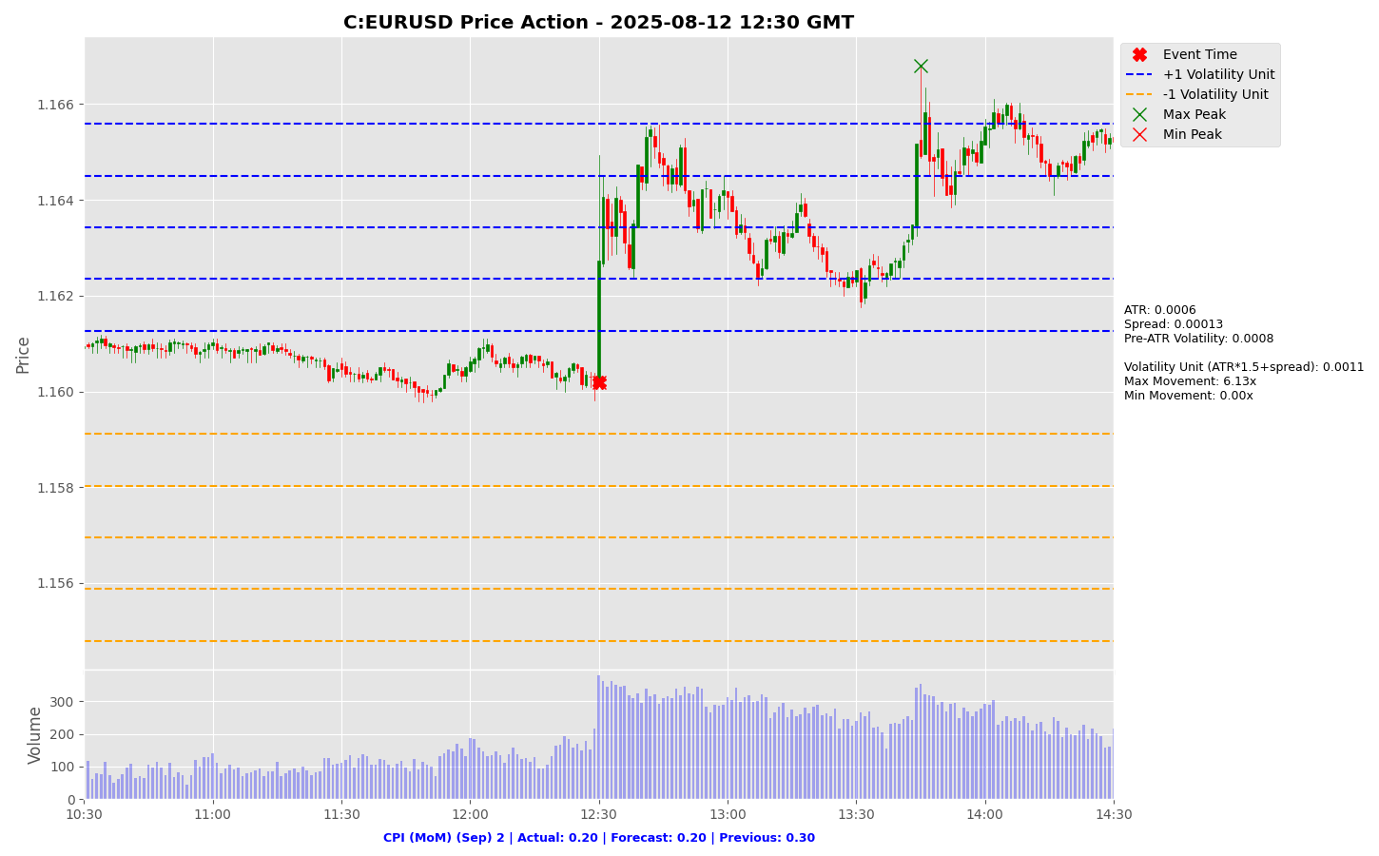

Slide 66


Slide 67
Project Spider Accelerating the Energy Transition 4thMar 2024 Pawan Quantwater Tech Investments
GDP (MoM) (Aug)

Slide 68
GDP (MoM) (Aug)
Event | GDP (MoM) (Aug) |  |  | Description
Actual: |  |  |  | Gross Domestic Product (GDP) measures the annualized change in the inflation-adjusted value of all goods and services produced by the economy. It is the broadest measure of economic activity and the primary indicator of the economy's health. A higher than expected reading should be taken as positive/bullish for the GBP, while a lower than expected reading should be taken as negative/bearish for the GBP. Learn More: GBPJPY | GBPUSD
Forecast:
Previous: | 0.00%
Time (GMT): | 06:00
Release Date | Actual | Forecast | Previous
12-Sep-25 | 0.00% | 0.00% | 0.40%
14-Aug-25 | 0.40% | 0.20% | -0.10%
11-Jul-25 | -0.10% | 0.10% | -0.30%
12-Jun-25 | -0.30% | -0.10% | 0.20%
15-May-25 | 0.20% | 0.00% | 0.50%
11-Apr-25 | 0.50% | 0.10% | 0.00%

Slide 69
Project Spider Accelerating the Energy Transition 4thMar 2024 Pawan Quantwater Tech Investments
GDP (MoM) (Aug)
GBPJPY

Slide 70
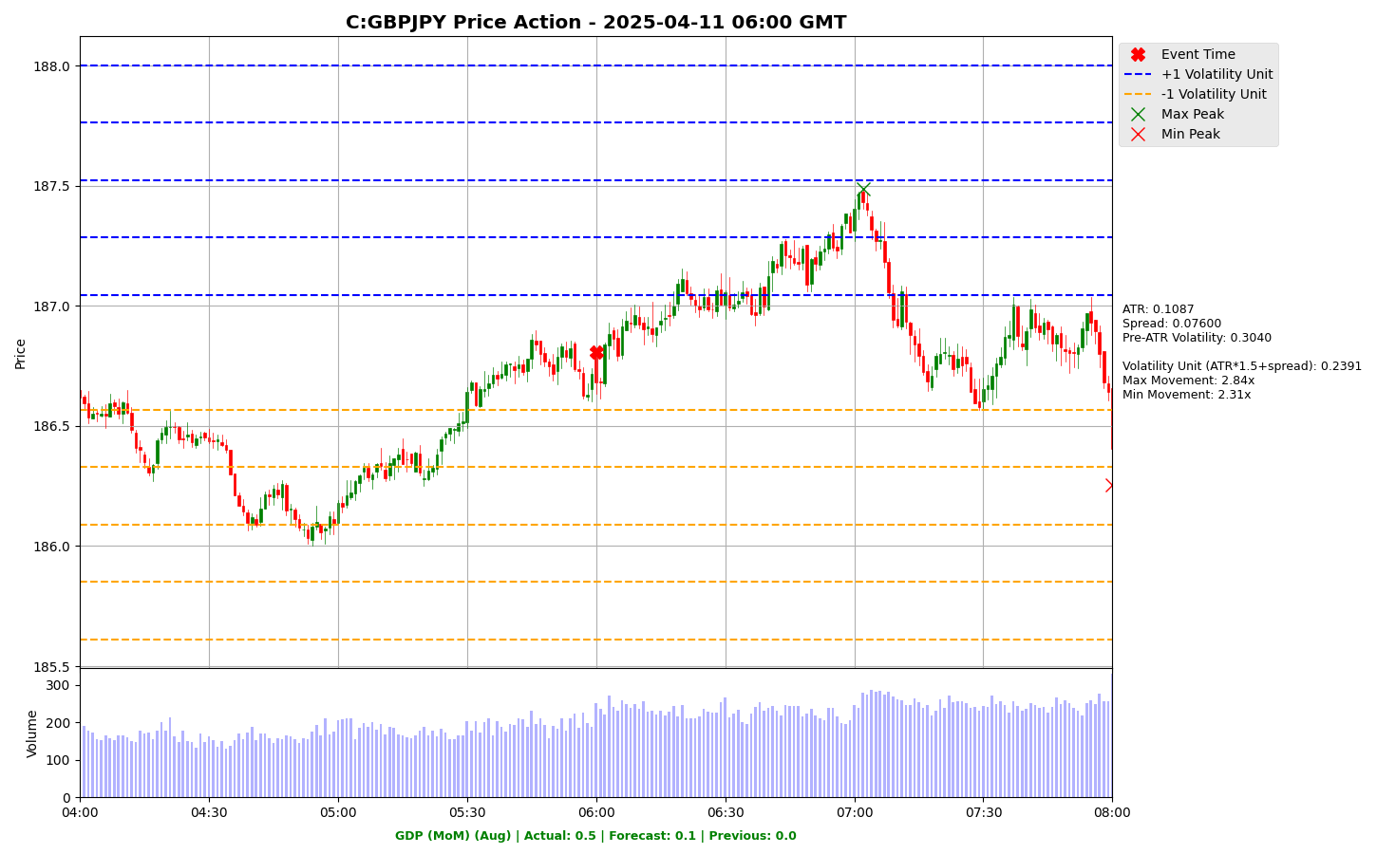

Slide 71
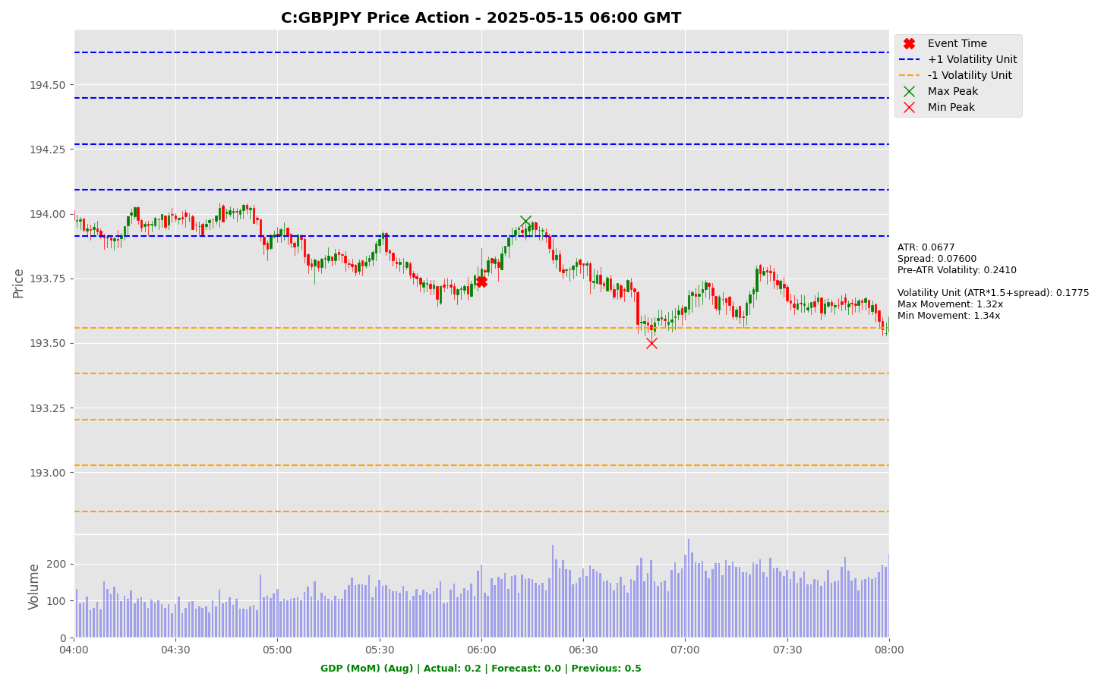

Slide 72
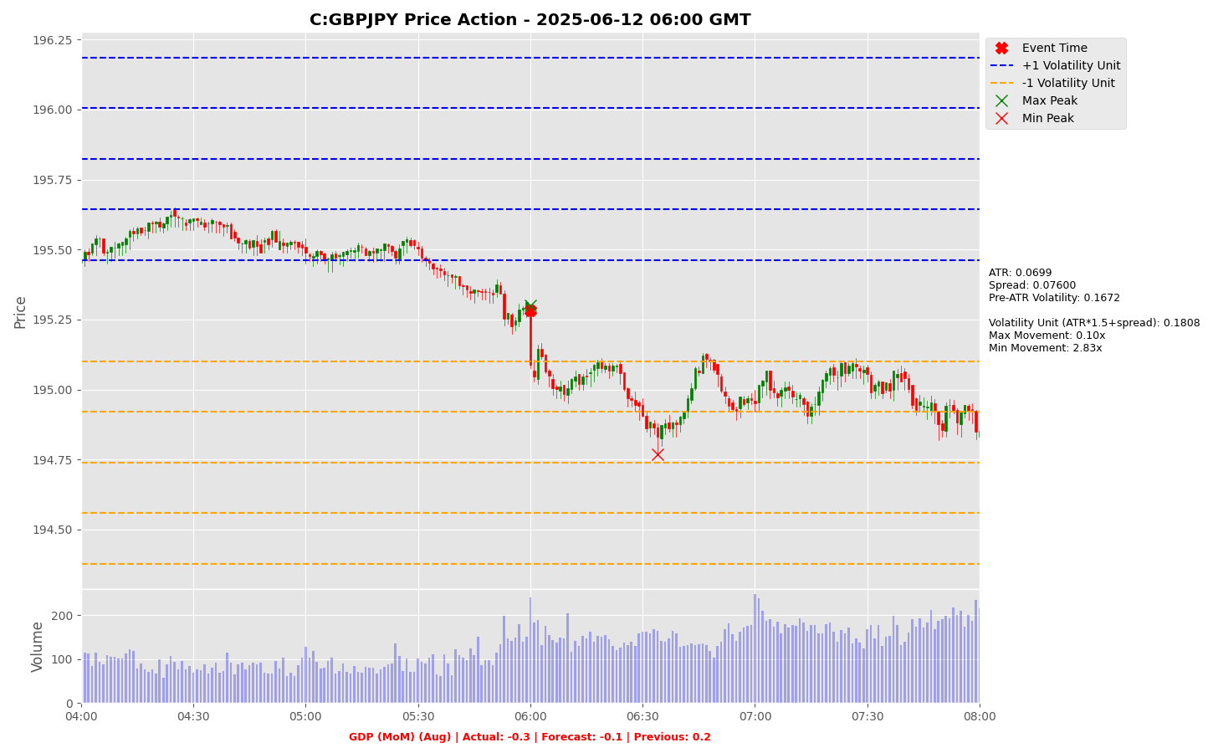

Slide 73
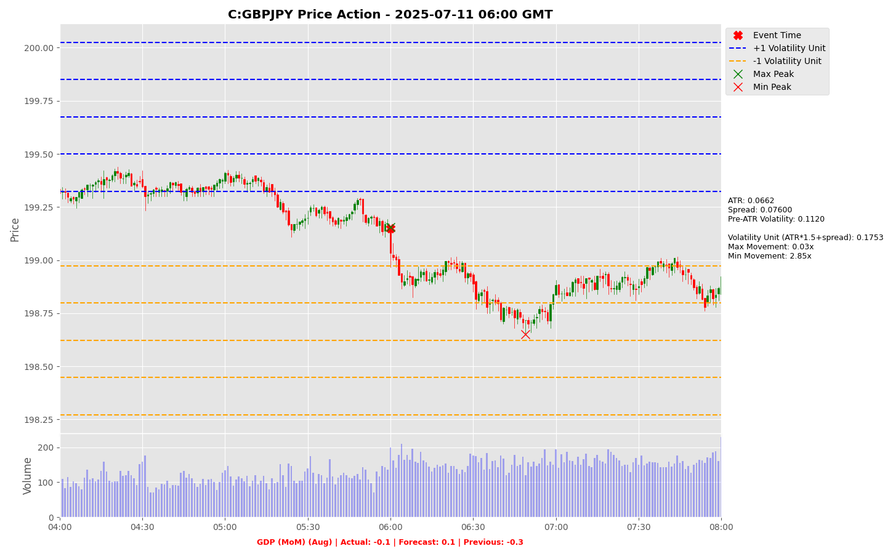

Slide 74
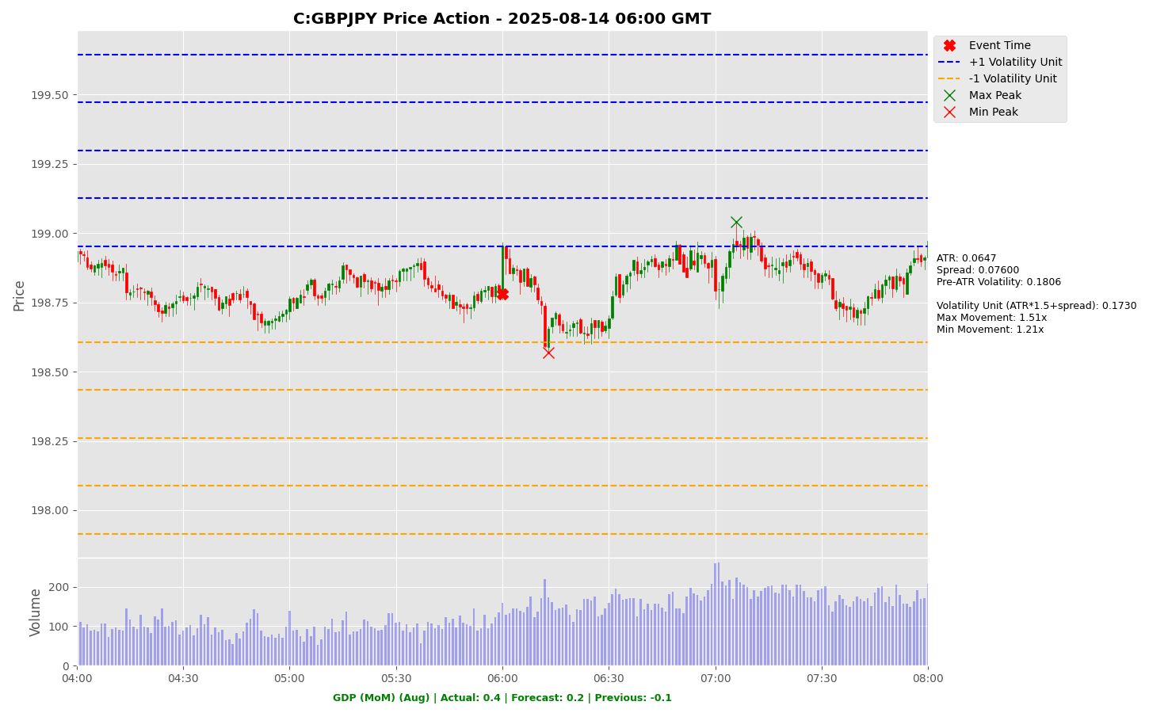

Slide 75
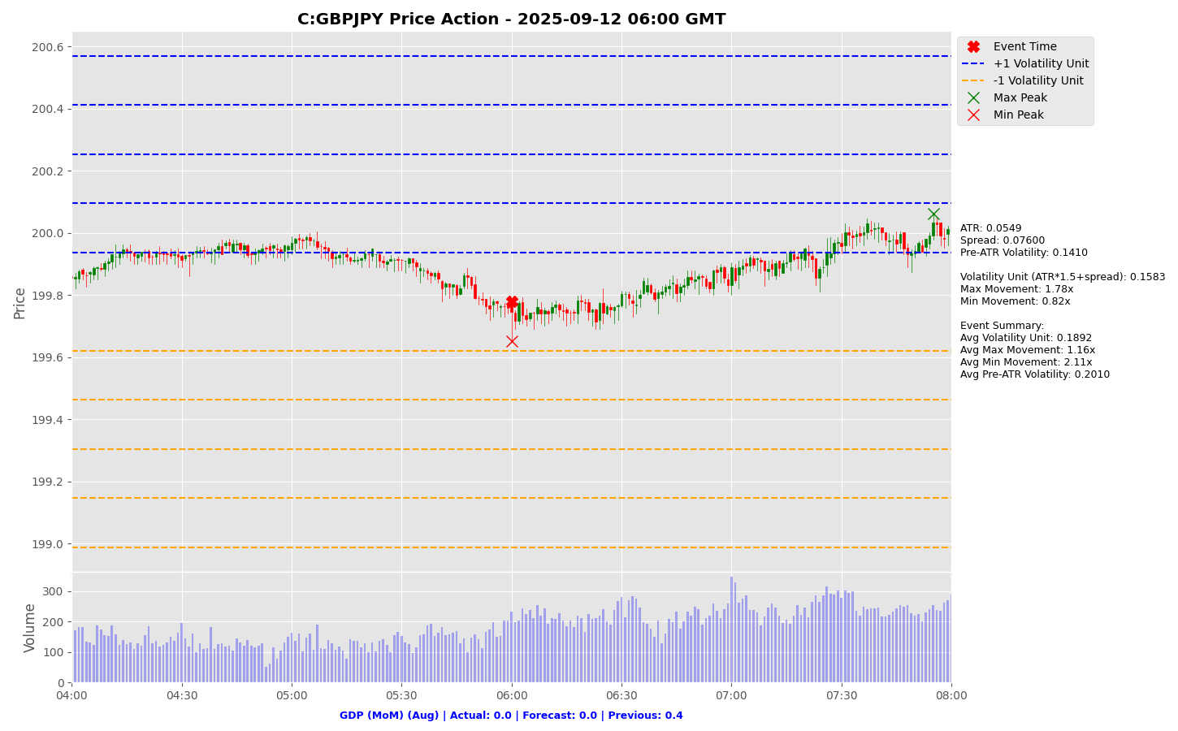

Slide 76
Project Spider Accelerating the Energy Transition 4thMar 2024 Pawan Quantwater Tech Investments
GDP (MoM) (Aug)
GBPUSD

Slide 77
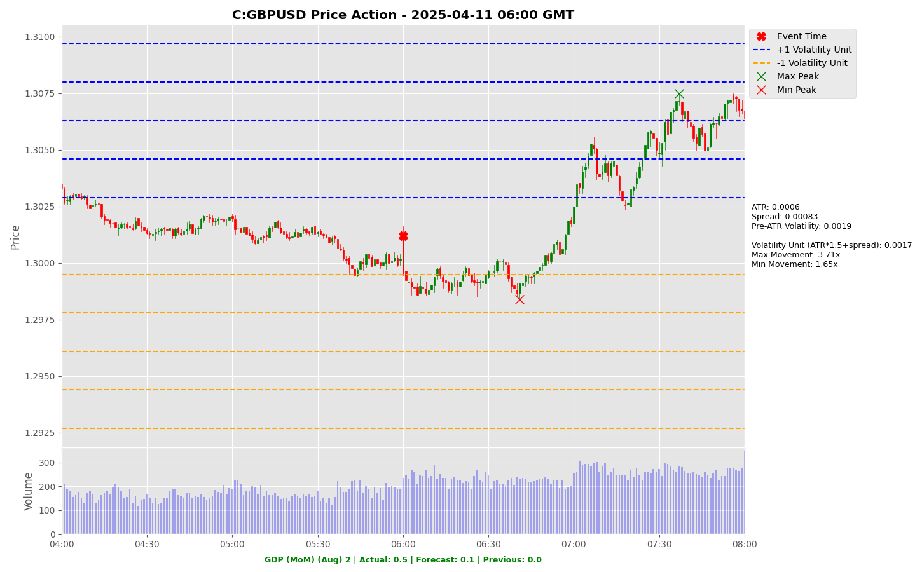

Slide 78
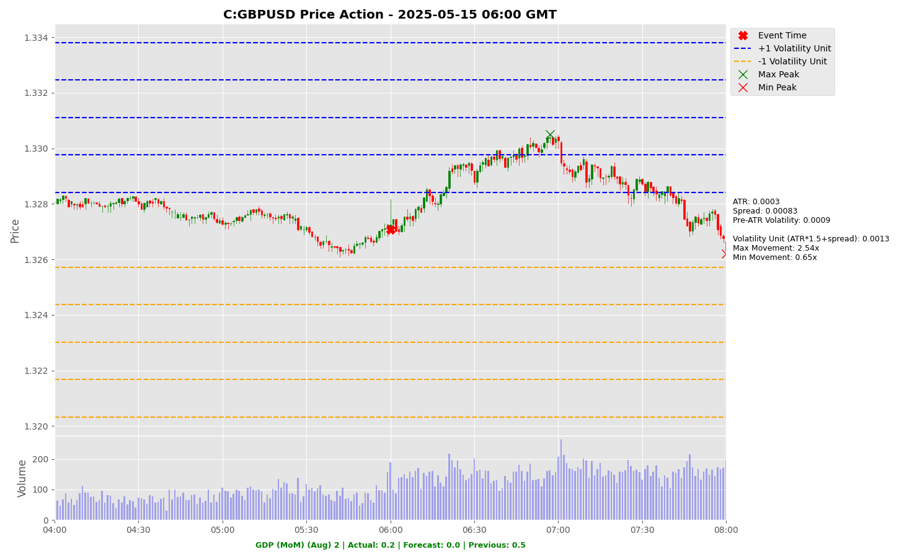

Slide 79
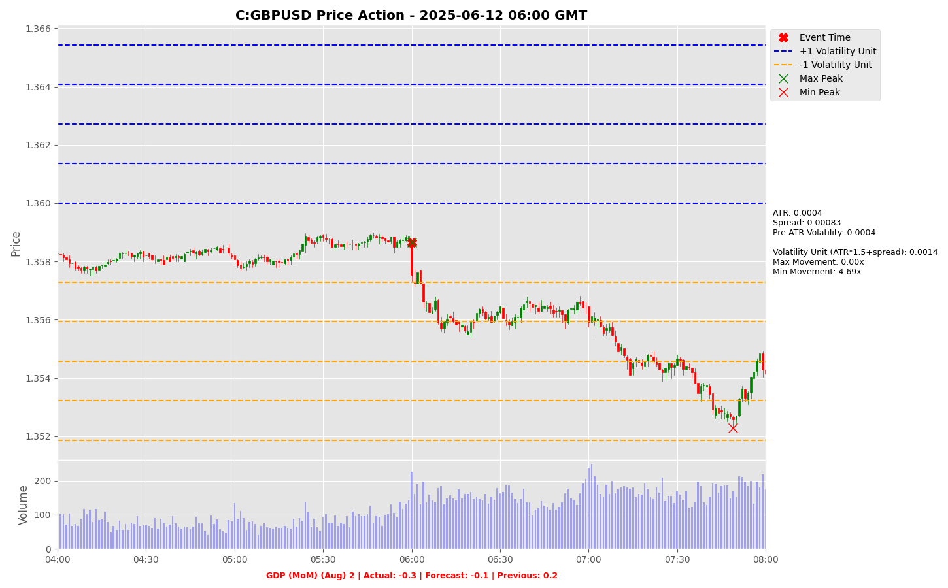

Slide 80


Slide 81


Slide 82


Slide 83
Project Spider Accelerating the Energy Transition 4thMar 2024 Pawan Quantwater Tech Investments
Core Retail Sales (MoM) (Sep)

Slide 84
Core Retail Sales (MoM) (Sep)
Event | Core Retail Sales (MoM) (Sep) |  |  | Description
Actual: |  |  |  | Core Retail Sales measures the change in the total value of sales at the retail level in the U.S., excluding automobiles. It is an important indicator of consumer spending and is also considered as a pace indicator for the U.S. economy. A higher than expected reading should be taken as positive/bullish for the USD, while a lower than expected reading should be taken as negative/bearish for the USD. Learn More: USDJPY | EURUSD
Forecast:
Previous: | 0.70%
Time (GMT): | 12:30
Release Date | Actual | Forecast | Previous
16-Sep-25 | 0.70% | 0.40% | 0.40%
15-Aug-25 | 0.30% | 0.30% | 0.80%
17-Jul-25 | 0.50% | 0.30% | -0.20%
17-Jun-25 | -0.30% | 0.20% | 0.00%
15-May-25 | 0.10% | 0.30% | 0.80%
16-Apr-25 | 0.50% | 0.40% | 0.70%

Slide 85
Project Spider Accelerating the Energy Transition 4thMar 2024 Pawan Quantwater Tech Investments
Core Retail Sales (MoM) (Sep)
USDJPY

Slide 86


Slide 87


Slide 88


Slide 89


Slide 90


Slide 91


Slide 92
Project Spider Accelerating the Energy Transition 4thMar 2024 Pawan Quantwater Tech Investments
Core Retail Sales (MoM) (Sep)
EURUSD

Slide 93


Slide 94


Slide 95


Slide 96


Slide 97


Slide 98


Slide 99
Project Spider Accelerating the Energy Transition 4thMar 2024 Pawan Quantwater Tech Investments
Philadelphia Fed Manufacturing Index (Oct)

Slide 100
Philadelphia Fed Manufacturing Index (Oct)
Event | Philadelphia Fed Manufacturing Index (Oct) |  |  | Description
Actual: |  |  |  | The Philadelphia Federal Reserve Manufacturing Index rates the relative level of general business conditions in Philadelphia. A level above zero on the index indicates improving conditions; below indicates worsening conditions. The data is compiled from a survey of about 250 manufacturers in the Philadelphia Federal Reserve district. A higher than expected reading should be taken as positive/bullish for the USD, while a lower than expected reading should be taken as negative/bearish for the USD. Learn More: USDJPY | EURUSD
Forecast:
Previous: | 23.20
Time (GMT): | 12:30
Release Date | Actual | Forecast | Previous
Sep 18, 2025 | 23.20 | 1.70 | (0.30)
Aug 21, 2025 | (0.30) | 6.80 | 15.90
Jul 17, 2025 | 15.90 | (1.20) | (4.00)
Jun 20, 2025 | (4.00) | (1.70) | (4.00)
May 15, 2025 | (4.00) | (11.30) | (26.40)
Apr 17, 2025 | (26.40) | 2.20 | 12.50

Slide 101
Project Spider Accelerating the Energy Transition 4thMar 2024 Pawan Quantwater Tech Investments
Philadelphia Fed Manufacturing Index (Oct)
USDJPY

Slide 102


Slide 103


Slide 104


Slide 105


Slide 106


Slide 107


Slide 108
Project Spider Accelerating the Energy Transition 4thMar 2024 Pawan Quantwater Tech Investments
Philadelphia Fed Manufacturing Index (Oct)
EURUSD

Slide 109


Slide 110


Slide 111


Slide 112


Slide 113


Slide 114


Slide 115
Project Spider Accelerating the Energy Transition 4thMar 2024 Pawan Quantwater Tech Investments
PPI (MoM) (Sep)

Slide 116
PPI (MoM) (Sep)
Event | PPI (MoM) (Sep) |  |  | Description
Actual: |  |  |  | The Producer Price Index (PPI) measures the change in the price of goods sold by manufacturers. It is a leading indicator of consumer price inflation, which accounts for the majority of overall inflation. A higher than expected reading should be taken as positive/bullish for the USD, while a lower than expected reading should be taken as negative/bearish for the USD. Learn More: USDJPY | EURUSD
Forecast:
Previous: | -0.10%
Time (GMT): | 12:30
Release Date | Actual | Forecast | Previous
10-Sep-25 | -0.1% | 0.3% | 0.7%
14-Aug-25 | 0.9% | 0.2% | 0.0%
16-Jul-25 | 0.0% | 0.2% | 0.3%
12-Jun-25 | 0.1% | 0.2% | -0.2%
15-May-25 | -0.5% | 0.2% | 0.0%
11-Apr-25 | -0.4% | 0.2% | 0.1%

Slide 117
Project Spider Accelerating the Energy Transition 4thMar 2024 Pawan Quantwater Tech Investments
PPI (MoM) (Sep)
USDJPY

Slide 118


Slide 119


Slide 120


Slide 121


Slide 122


Slide 123


Slide 124
Project Spider Accelerating the Energy Transition 4thMar 2024 Pawan Quantwater Tech Investments
PPI (MoM) (Sep)
EURUSD

Slide 125


Slide 126


Slide 127


Slide 128


Slide 129


Slide 130


Slide 131
Project Spider Accelerating the Energy Transition 4thMar 2024 Pawan Quantwater Tech Investments
Retail Sales (MoM) (Sep)

Slide 132
Retail Sales (MoM) (Sep)
Event | Retail Sales (MoM) (Sep) |  |  | Description
Actual: |  |  |  | Retail Sales measure the change in the total value of sales at the retail level. It is the foremost indicator of consumer spending, which accounts for the majority of overall economic activity. A higher than expected reading should be taken as positive/bullish for the USD, while a lower than expected reading should be taken as negative/bearish for the USD. Learn More: USDJPY | EURUSD
Forecast:
Previous: | 0.60%
Time (GMT): | 12:30
Release Date | Actual | Forecast | Previous
16-Sep-25 | 0.60% | 0.20% | 0.60%
15-Aug-25 | 0.50% | 0.60% | 0.90%
17-Jul-25 | 0.60% | 0.10% | -0.90%
17-Jun-25 | -0.90% | -0.50% | -0.10%
15-May-25 | 0.10% | 0.00% | 1.70%
16-Apr-25 | 1.40% | 1.30% | 0.20%

Slide 133
Project Spider Accelerating the Energy Transition 4thMar 2024 Pawan Quantwater Tech Investments
Retail Sales (MoM) (Sep)
USDJPY

Slide 134


Slide 135


Slide 136


Slide 137


Slide 138


Slide 139


Slide 140
Project Spider Accelerating the Energy Transition 4thMar 2024 Pawan Quantwater Tech Investments
Retail Sales (MoM) (Sep)
EURUSD

Slide 141


Slide 142


Slide 143


Slide 144


Slide 145


Slide 146


Slide 147
Project Spider Accelerating the Energy Transition 4thMar 2024 Pawan Quantwater Tech Investments
CPI (YoY) (Sep)

Slide 148
CPI (YoY) (Sep)
Event | CPI (YoY) (Sep) |  |  | Description
Actual: |  |  |  | The Consumer Price Index (CPI) measures the change in the price of goods and services from the perspective of the consumer. It is a key way to measure changes in purchasing trends and inflation. A higher than expected reading should be taken as positive/bullish for the EUR, while a lower than expected reading should be taken as negative/bearish for the EUR. Learn More: EURJPY | EURUSD
Forecast:
Previous: | 2.20%
Time (GMT): | 09:00
Release Date | Actual | Forecast | Previous
01-Oct-25 | 2.20% | 2.20% | 2.00%
17-Sep-25 | 2.00% | 2.10% | 2.00%
02-Sep-25 | 2.10% | 2.10% | 2.00%
20-Aug-25 | 2.00% | 2.00% | 2.00%
01-Aug-25 | 2.00% | 1.90% | 2.00%
17-Jul-25 | 2.00% | 2.00% | 1.90%

Slide 149
Project Spider Accelerating the Energy Transition 4thMar 2024 Pawan Quantwater Tech Investments
CPI (YoY) (Sep)
EURJPY

Slide 150


Slide 151


Slide 152


Slide 153


Slide 154


Slide 155


Slide 156
Project Spider Accelerating the Energy Transition 4thMar 2024 Pawan Quantwater Tech Investments
CPI (YoY) (Sep)
EURUSD

Slide 157


Slide 158


Slide 159


Slide 160


Slide 161


Slide 162


Slide 163
Important Information
Quantwater Tech Investments
Data Release Deck – 12th October 2025
This document is for informational purposes only and does not constitute investment advice, an offer, or a solicitation to buy or sell any securities or financial instruments.
Past performance is not indicative of future results. Investments involve inherent risks, including the possible loss of principal. No representation or warranty, express or implied, is made regarding the accuracy, completeness, or reliability of the information contained herein.
The information in this presentation is derived from publicly available sources and internal analysis as of the date indicated and is subject to change without notice. Quantwater Tech Investments and its affiliates do not undertake any obligation to update or revise this material.
Neither Quantwater Tech Investments nor any of its affiliates, officers, or employees shall be liable for any direct or indirect losses arising from the use of this information. Any misrepresentation is strictly prohibited.

Slide 164
Key Economic & Analytical Concepts
Economic Data Interpretation
Price Movements
Forecast Vs. Actual: Comparing predicted values with released data
Previous Reading: Last reported value, used as a benchmark
Market Impact: How releases affect financial markets
Max Movement: Largest upward price move after event
Min Movement: Largest downward price move after event
Both measured in Volatility Units
Average True Range (ATR)
Using This Analysis
Definition: A technical indicator that measures market volatility
Calculations:
Calculate True Range (TR) for each period:
TR = max [(high - low), abs(high – previous close), abs(low – previous close)]
ATR = Simple moving average of TR over N periods (typically 14)
Interpretation:
Higher ATR = Higher Volatility
Lower ATR = Lower Volatility
Usage in Our Analysis:
Helps standardize price movements across different market conditions
Forms the basis of our Volatility Unit Calculations
Analyzing volatility across different economic releases helps identify patterns in market reactions.
This approach allows for evaluating the significance of economic indicators based on their market impact.
Adhering to standard trading guidelines, the risk amount should not exceed 5% of the trading balance, typically. A risk-reward ratio of 1:1.5x or greater, guided by the win ratio and historical data from this presentation or other estimates, can be used to determine the appropriate risk level, take-profit point, and position size.
Trade automation on the MT5/MT4 platform can be implemented using the expert advisor linked below, which takes the specified parameters as input.
An MT5/MT4 account can be accessed through a brokerage/securities dealer firm or by using a proprietary (prop) trading account.*
Example:
Volatility analysis of economic releases, such as the Consumer Price Index (CPI) event, helps identify patterns in market reactions. For instance, if the CPI event typically results in a minimum movement of 0.5x and a maximum movement of 3x, a stop-loss of 1x and a take-profit of 3x can be strategically applied.
Following prudent risk management, the risk per trade should not exceed 5% of the trading balance, typically. For a $100,000 trading account (max loss amount post which trading is halted), this translates to a $5,000 stop-loss and a $15,000 take-profit.
The guiding principle is that a win ratio of at least 50% combined with a risk-reward ratio of over 1.5-2x ensures positive expected cash flow. By limiting risk to 5% of the account balance, potential drawdowns from consecutive losses are minimized, preserving capital and maintaining positive cash flow expectations.
If you need further assistance, please don’t hesitate to contact us.
*Disclaimer: The links are provided for informational purposes only and connect to third-party websites. We are not affiliated with, nor do we endorse, any of these external sites. Trading carries a significant risk of financial loss. Your risk is your own responsibility, and you should carefully consider your investment objectives and risk tolerance before trading.
Volatility Unit
Resources
Formula: (ATR * multiple) + Spread (multiple is typically 1.5)
Purpose: Standardizes price movements
https://github.com/pawan-pro/quantwater-tech-investments/blob/main/QuantPulse
https://quantwatertech.netlify.app/research
https://quantwater.tech/blog
[]

Slide 165
Thank You!
Thank You!
Pawan Jatale
pawan@quantwater.tech
Founder
Quantwater Tech Investments

